Slide 1
American beaver
(Castor canadensis)

Slide 2
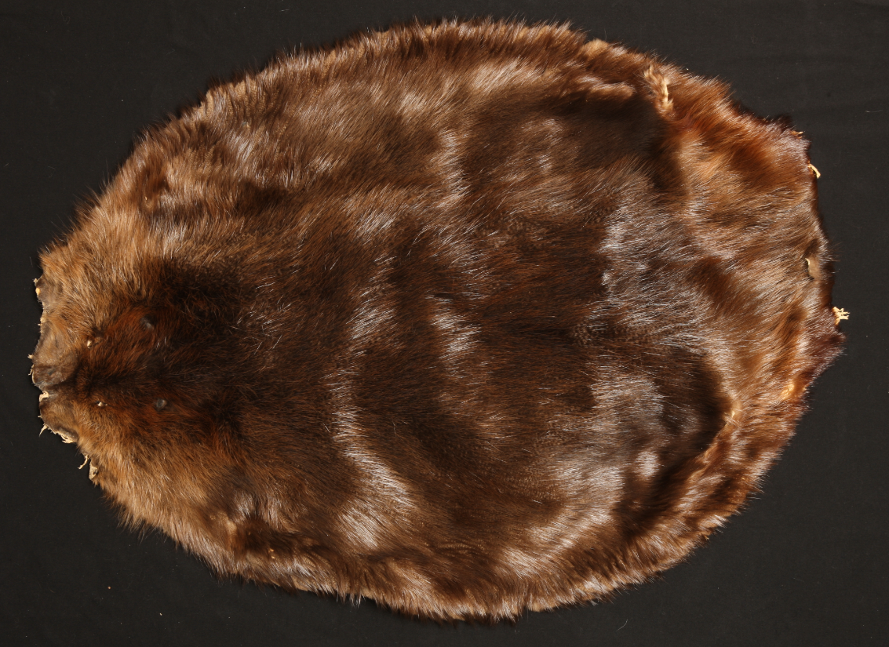
American beaver

Slide 4
coyote
(Canis latrans)

Slide 5
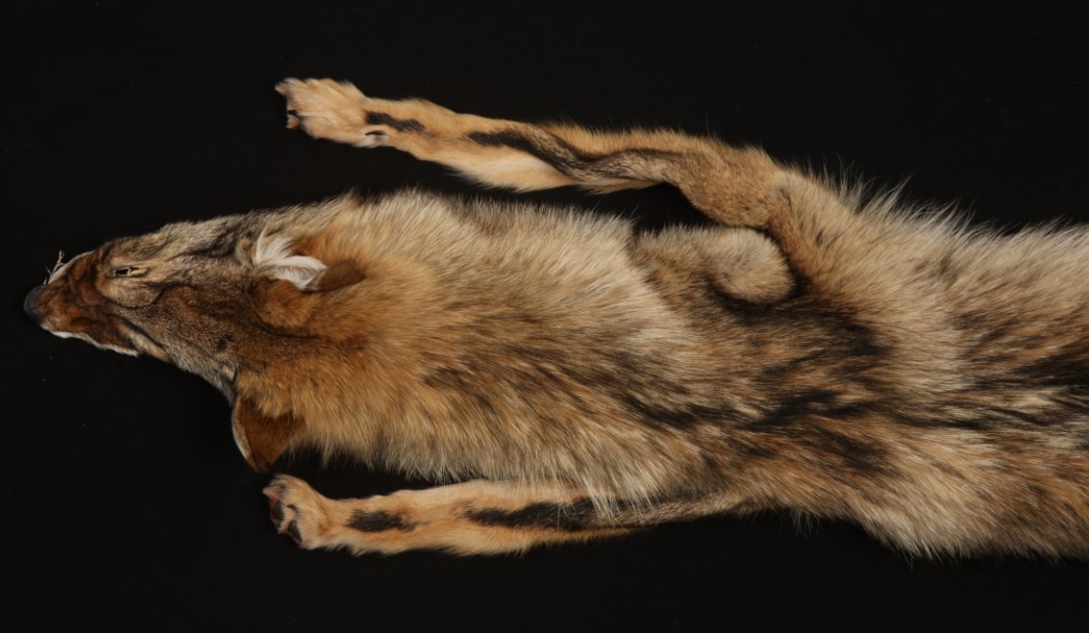
coyote
front

Slide 6
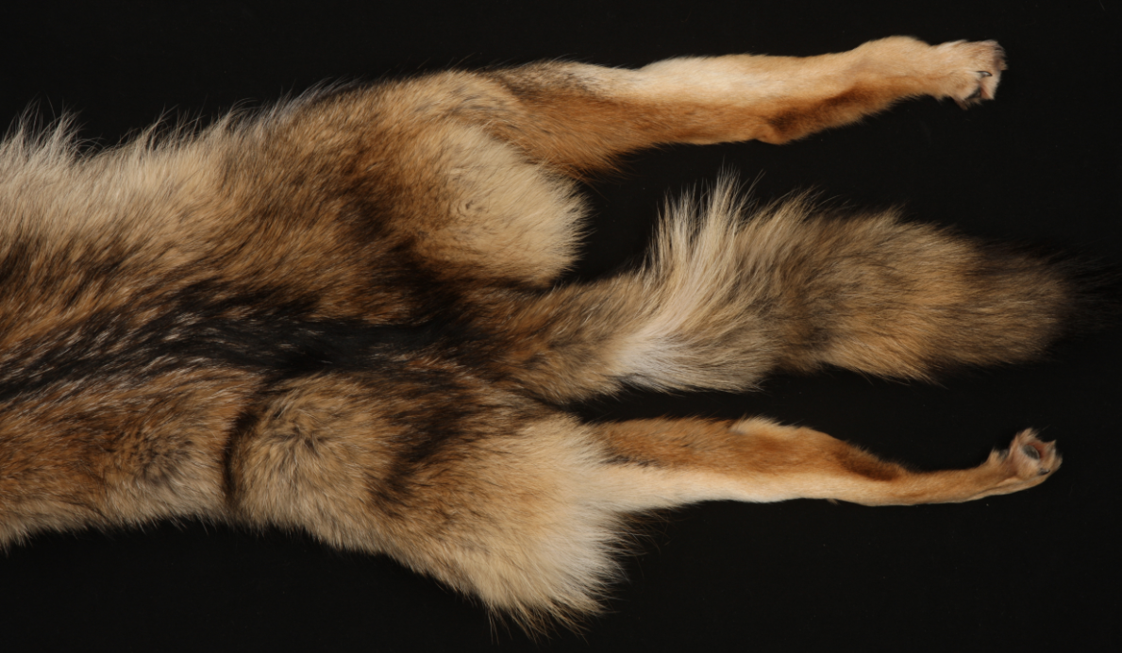
coyote
hind

Slide 9
white-tailed deer
(Odocoileus virginianus)

Slide 10
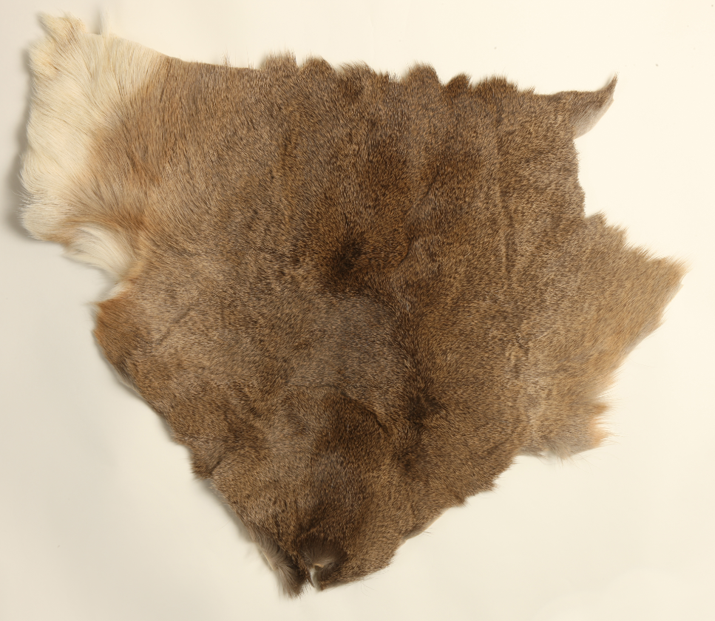
white-tailed deer
not an entire pelt

Slide 11
not an entire pelt

Slide 12
American mink
(Neovison vison)

Slide 13
American mink

Slide 15
muskrat
(Ondatra zibethicus)

Slide 16
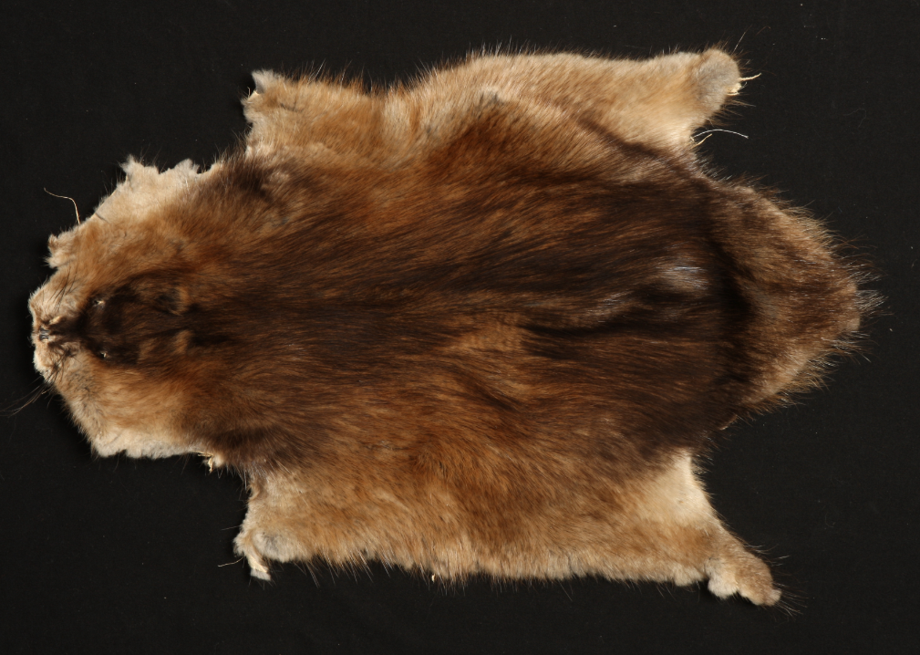
muskrat

Slide 18
Virginia opossum
(Didelphis virginiana)

Slide 19
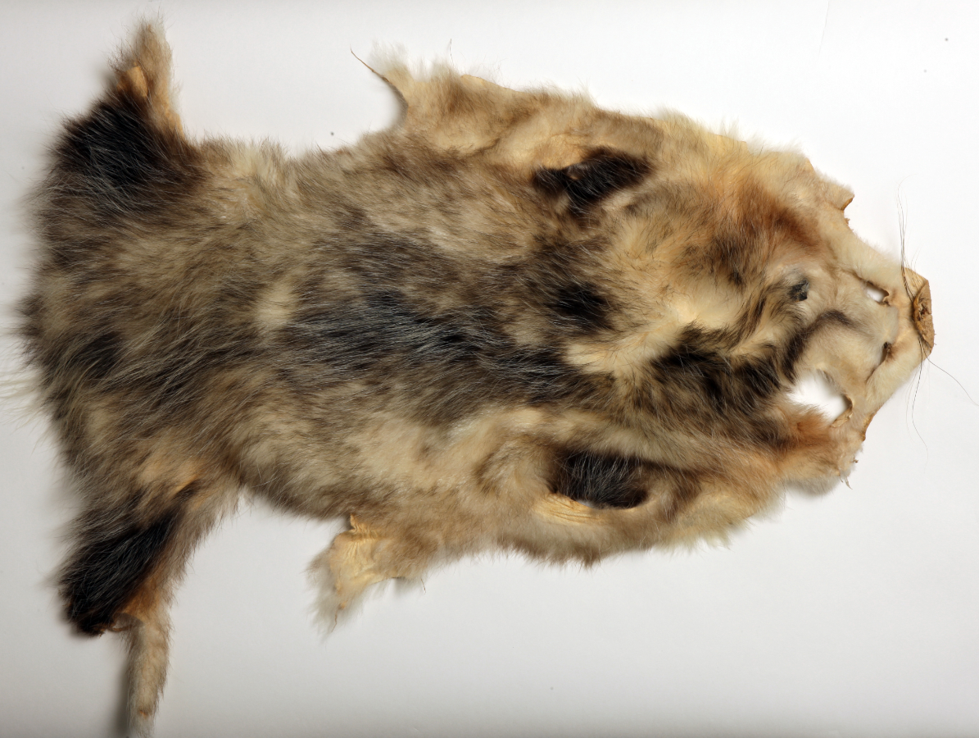
Virginia opossum

Slide 21
raccoon
(Procyon lotor)

Slide 22
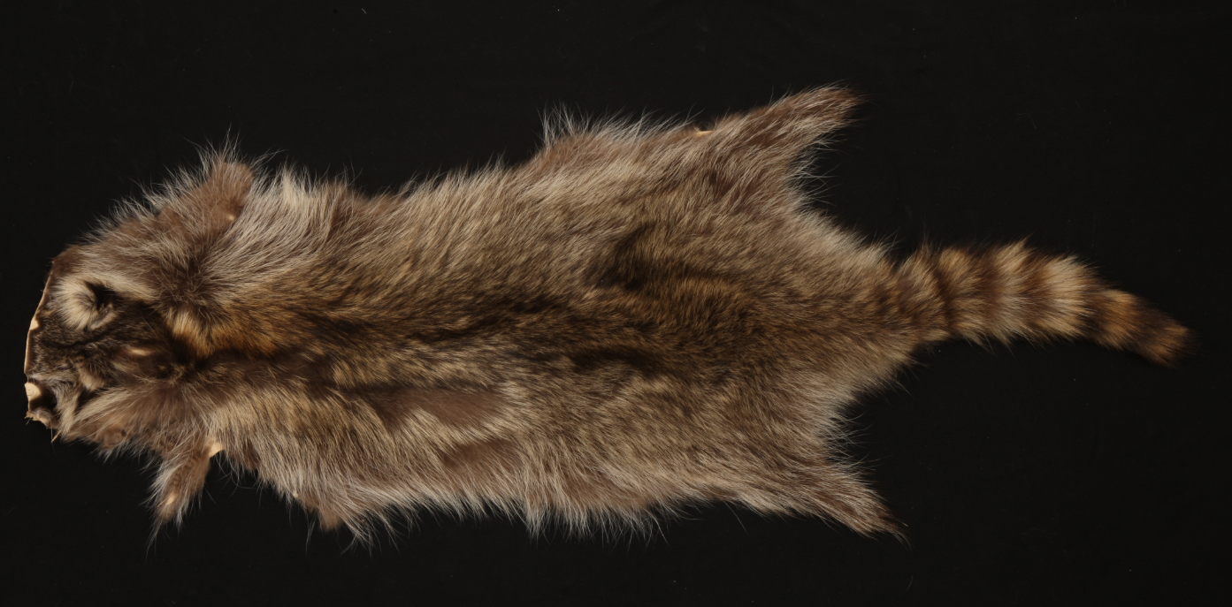
raccoon

Slide 24
red fox
(Vulpes vulpes)

Slide 25
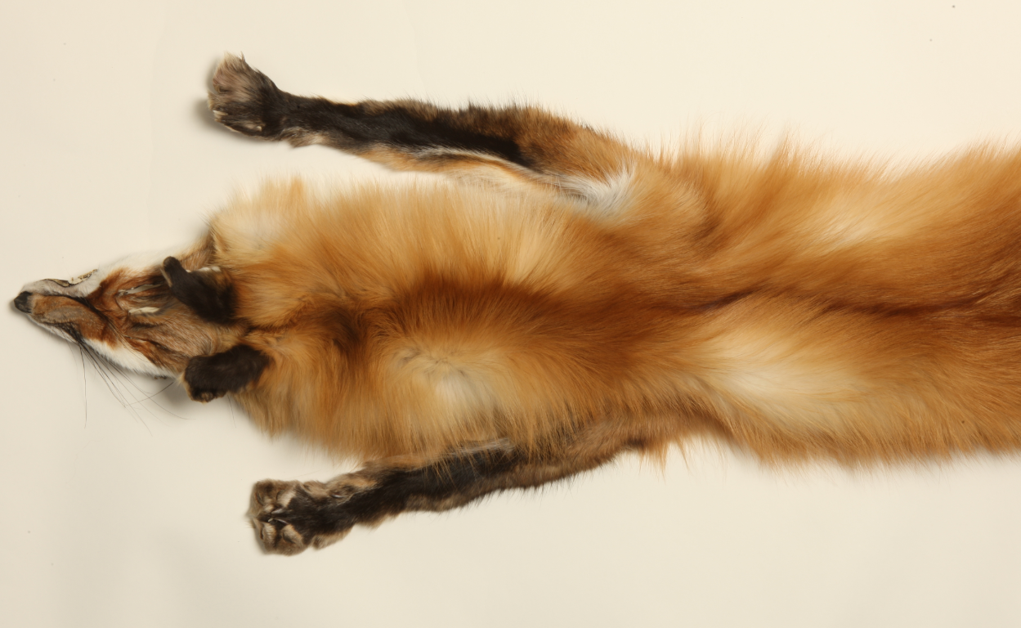
red fox
front

Slide 26
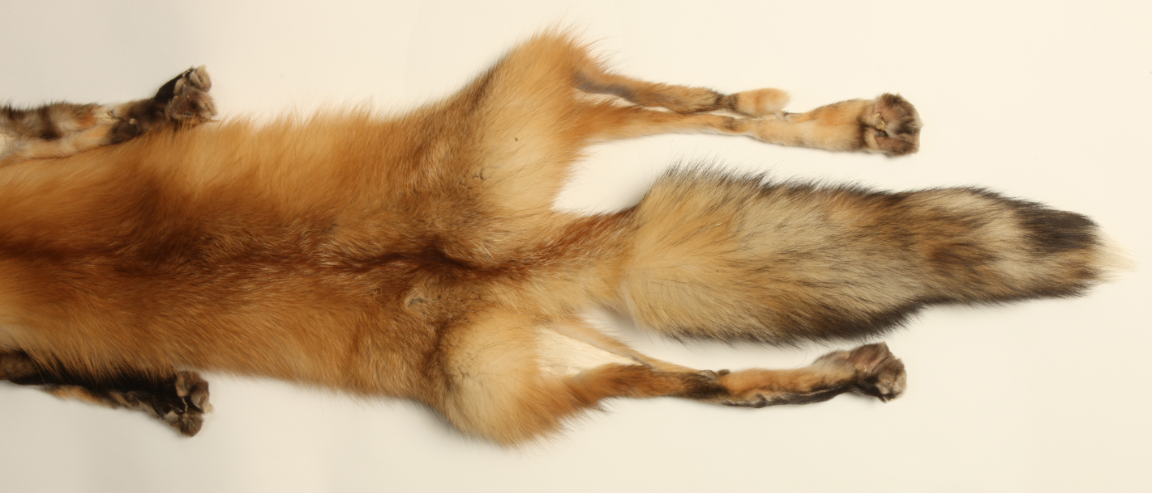
red fox
hind

Slide 29
striped skunk
(Mephitis mephitis)

Slide 30
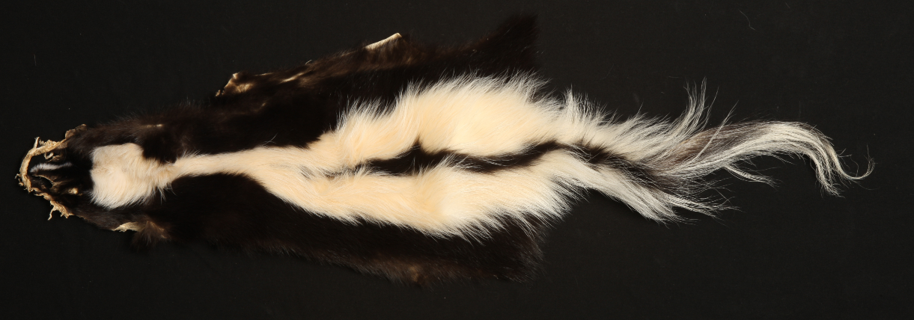
striped skunk

Slide 32
eastern fox squirrel
(Sciurus niger)

Slide 33
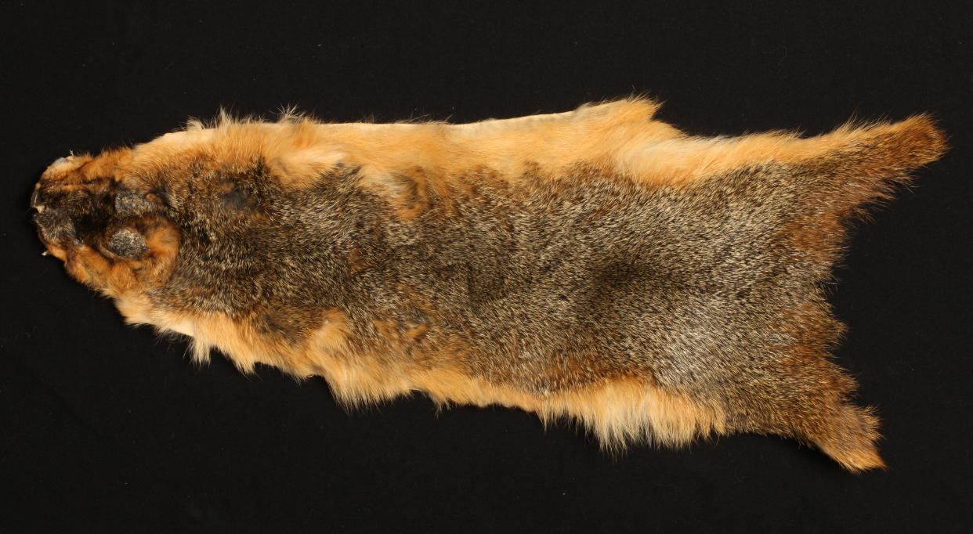
eastern fox squirrel

