Slide 1
American beaver
(Castor canadensis)

Slide 2
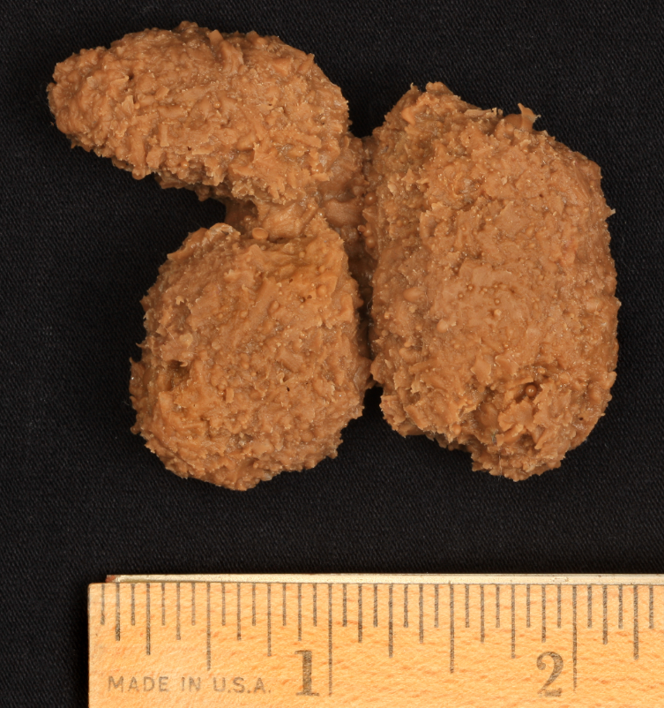
American beaver

Slide 3
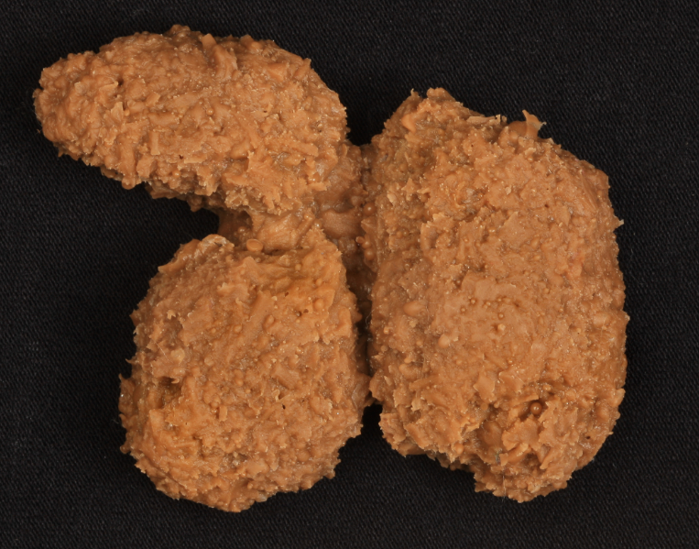
American beaver

Slide 6
coyote
(Canis latrans)

Slide 7
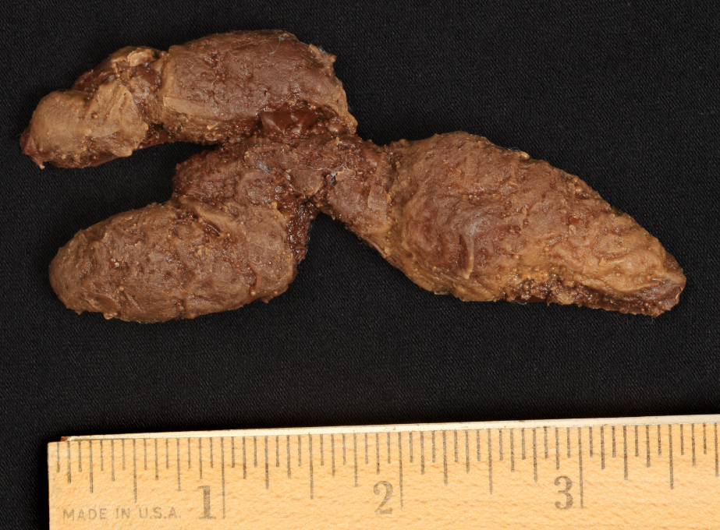
coyote

Slide 8
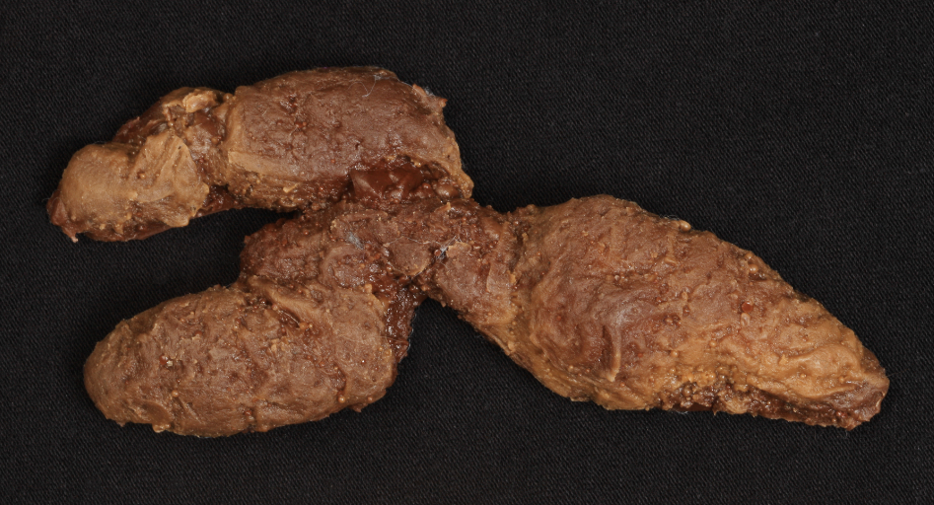
coyote

Slide 11
white-tailed deer
(Odocoileus virginianus)

Slide 12
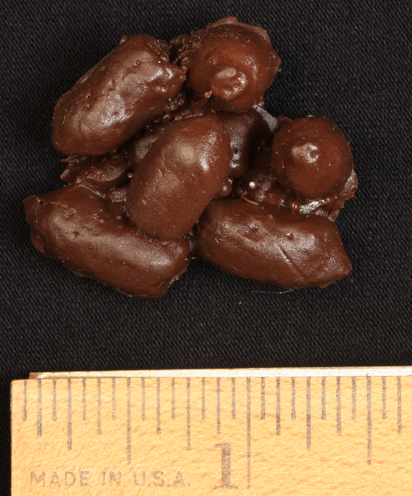
white-tailed deer

Slide 13
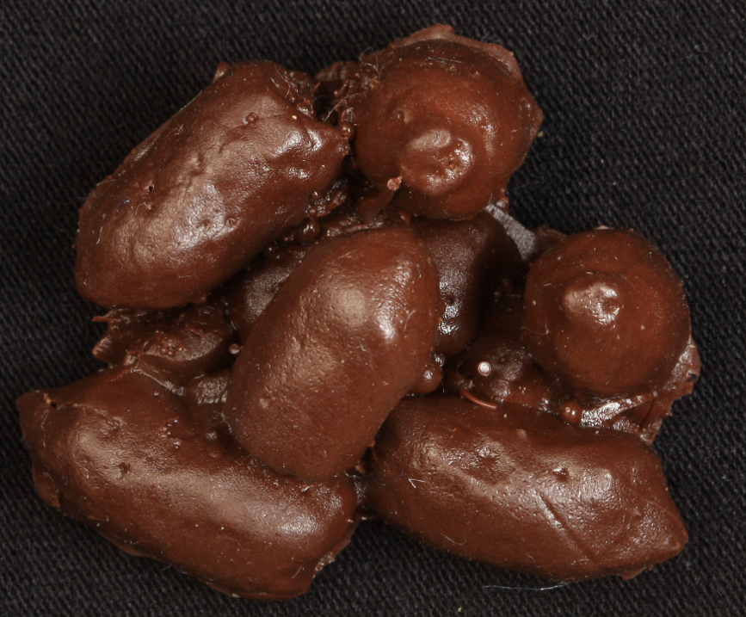
white-tailed deer

Slide 16
American mink
(Neovison vison)

Slide 17
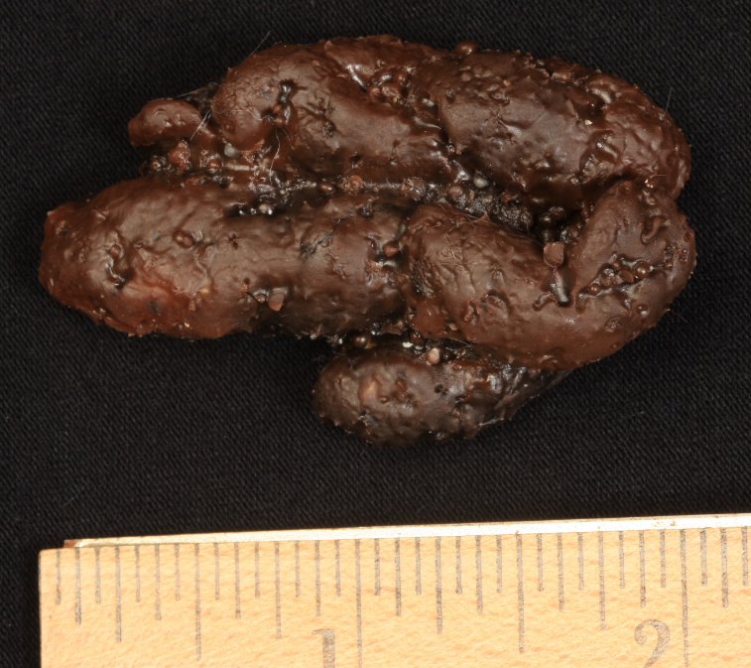
American mink

Slide 18
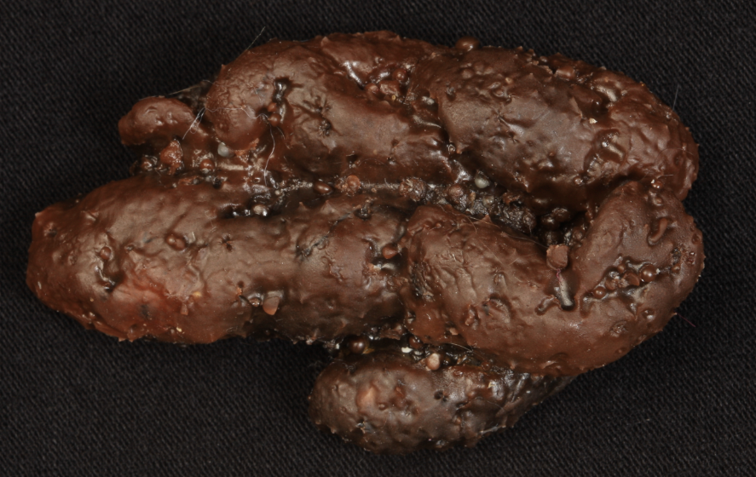
American mink

Slide 21
muskrat
(Ondatra zibethicus)

Slide 22
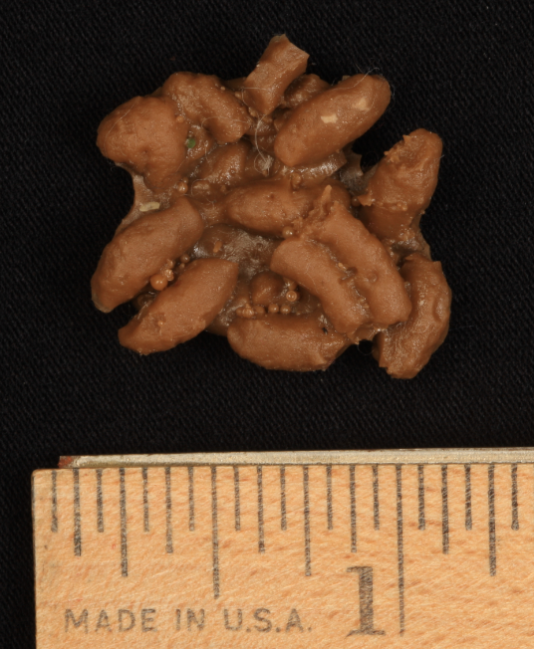
muskrat

Slide 23
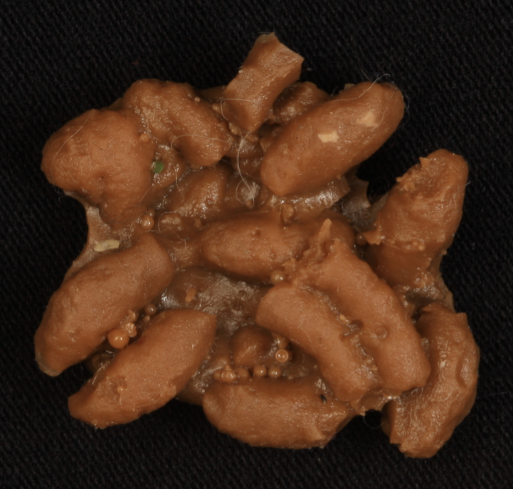
muskrat

Slide 26
Virginia opossum
(Didelphis virginiana)

Slide 27
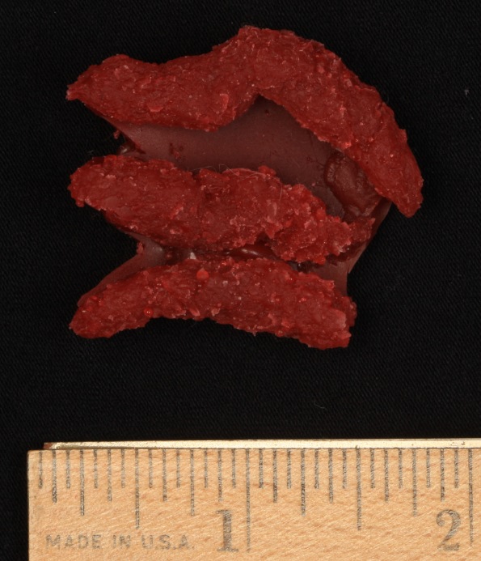
Virginia opossum

Slide 28
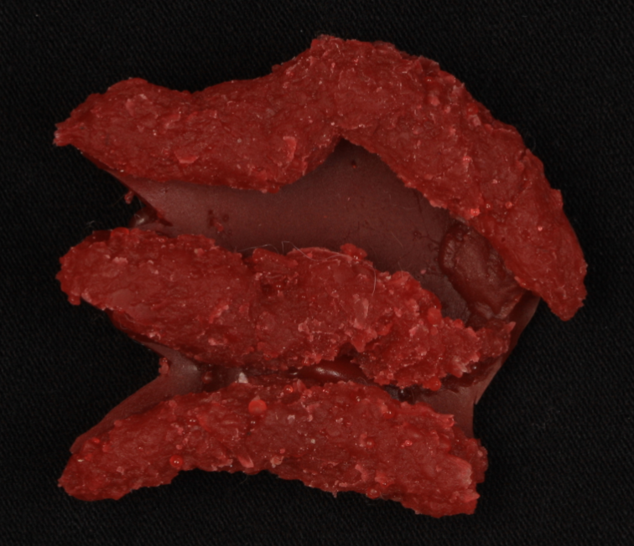
Virginia opossum

Slide 31
raccoon
(Procyon lotor)

Slide 32
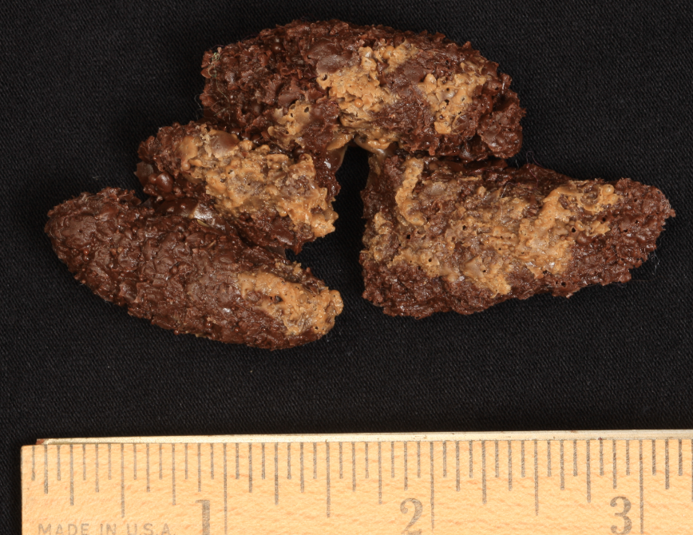
raccoon

Slide 33
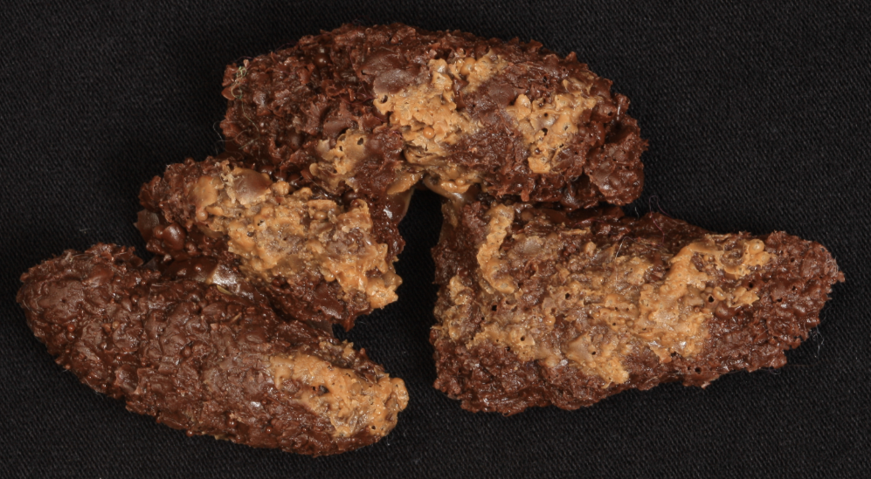
raccoon

Slide 36
red fox
(Vulpes vulpes)

Slide 37
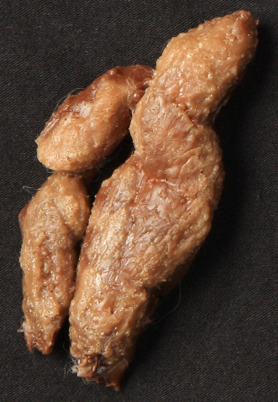
red fox

Slide 38
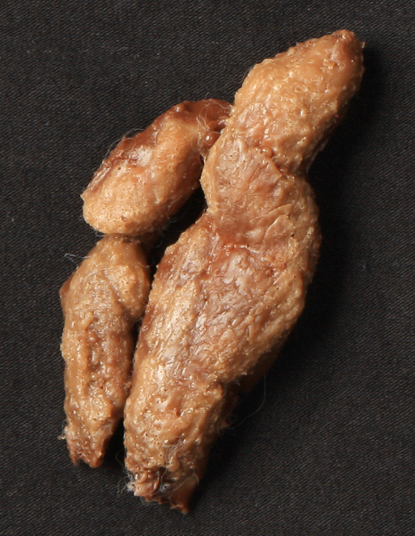
red fox

Slide 41
striped skunk
(Mephitis mephitis)

Slide 42
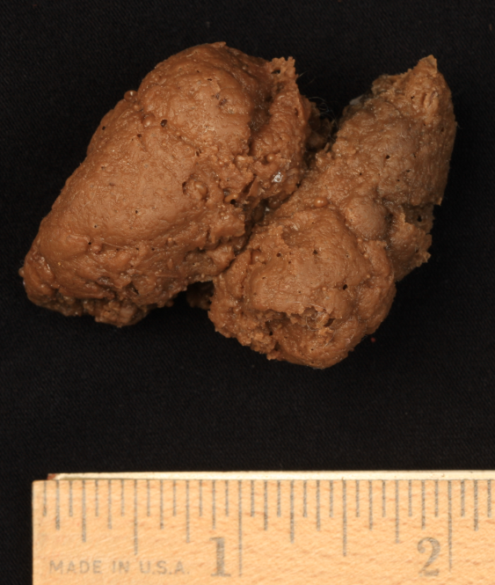
striped skunk

Slide 43
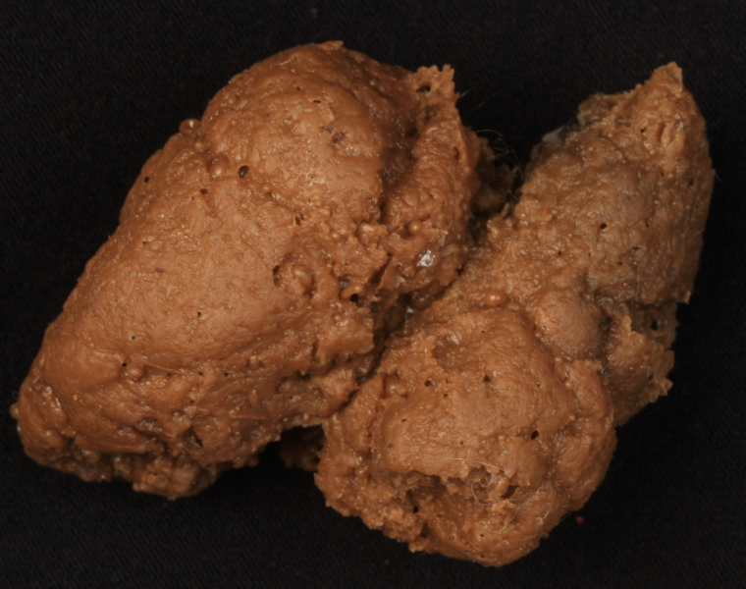
striped skunk

Slide 46
squirrel

Slide 47
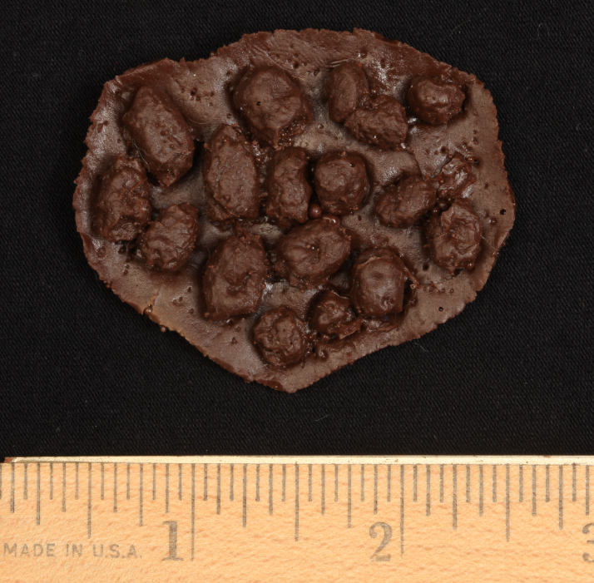
squirrel

Slide 48
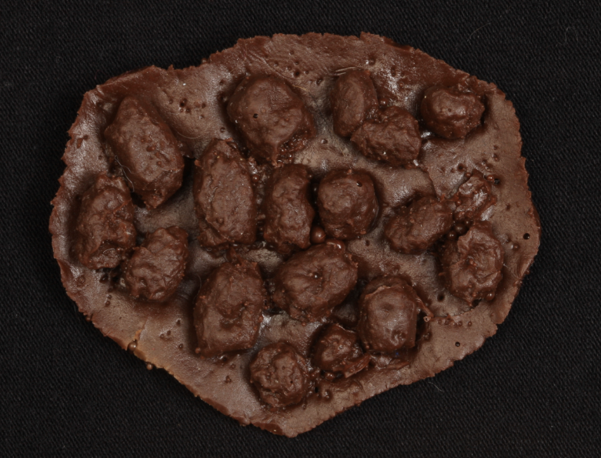
squirrel

Slide 51
