Slide 1
American beaver
(Castor canadensis)

Slide 2
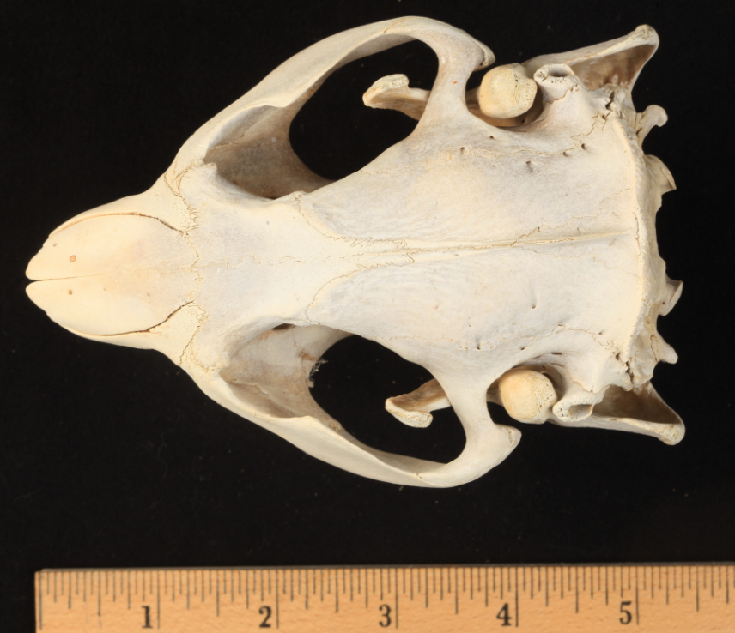
American beaver
top

Slide 3
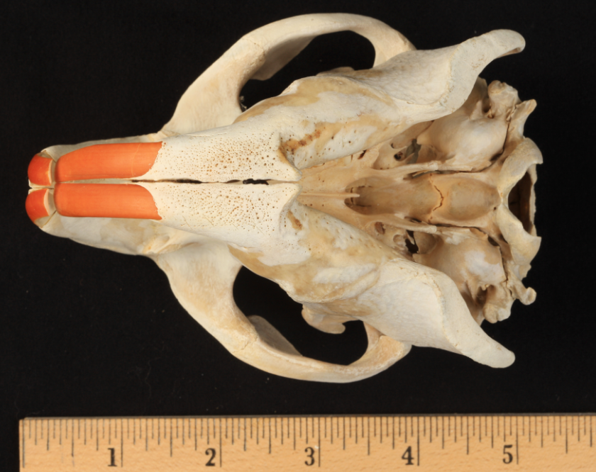
American beaver
bottom

Slide 4
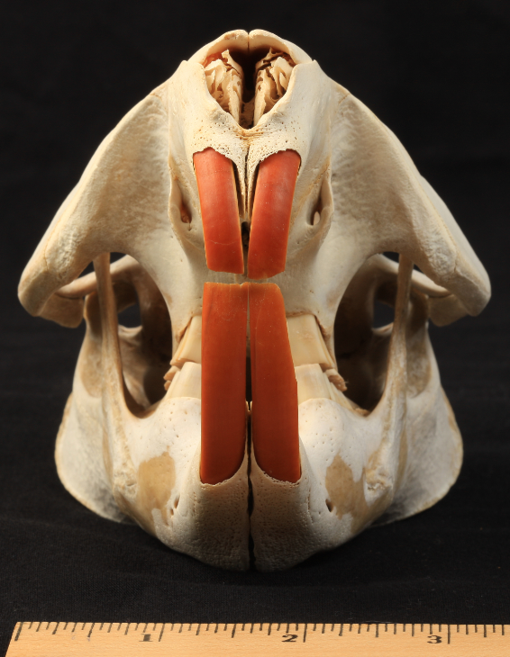
American beaver
front

Slide 5
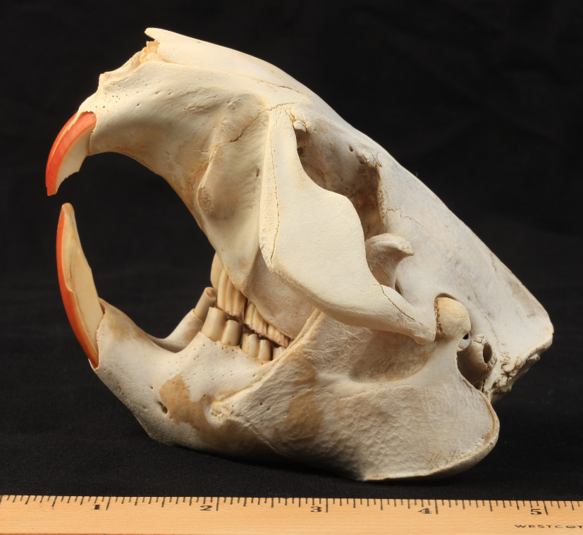
American beaver
side

Slide 10
coyote
(Canis latrans)

Slide 11
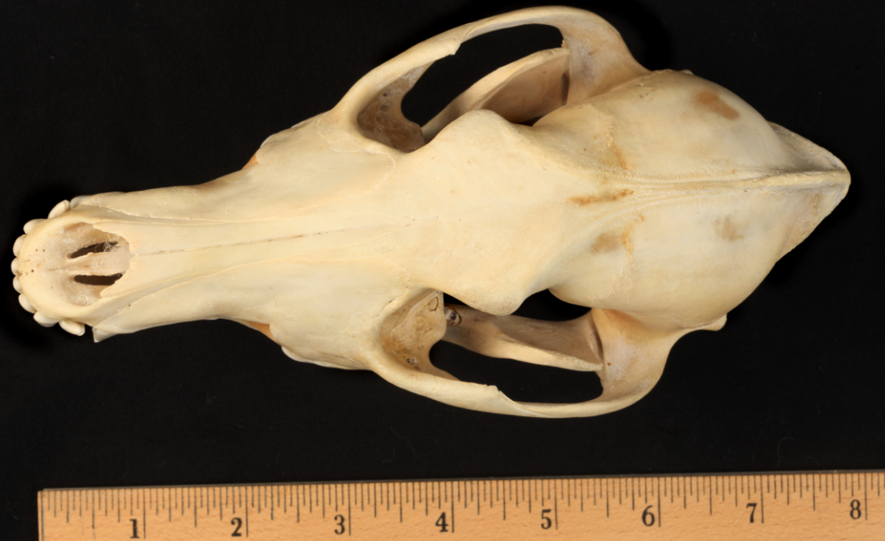
coyote
top

Slide 12
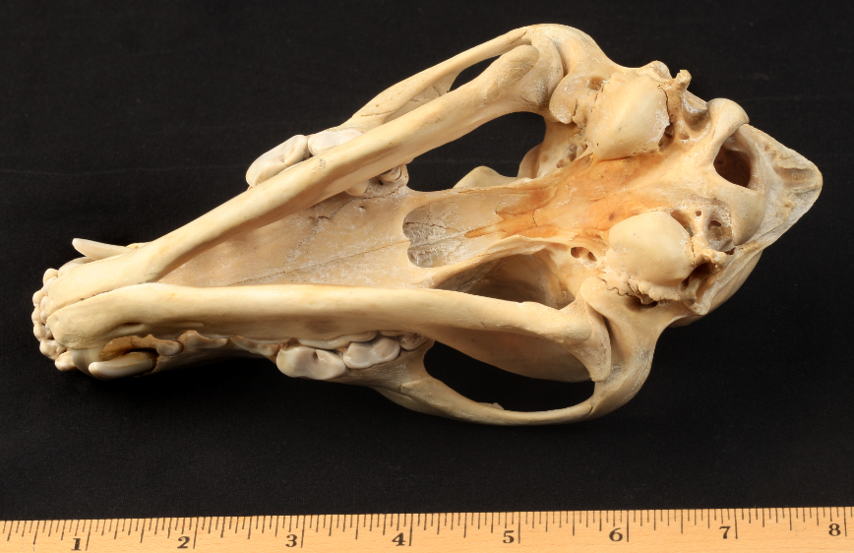
coyote
bottom

Slide 13
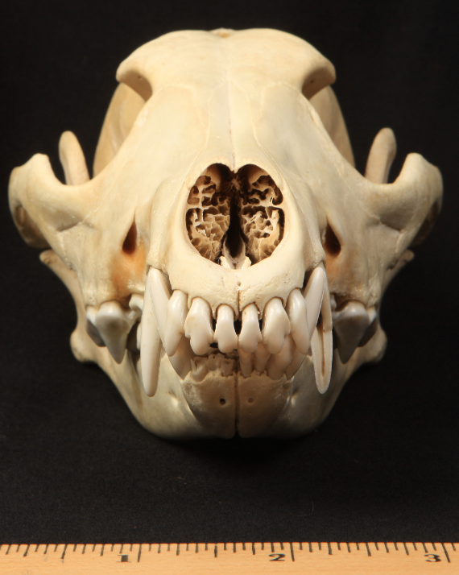
coyote
front

Slide 14
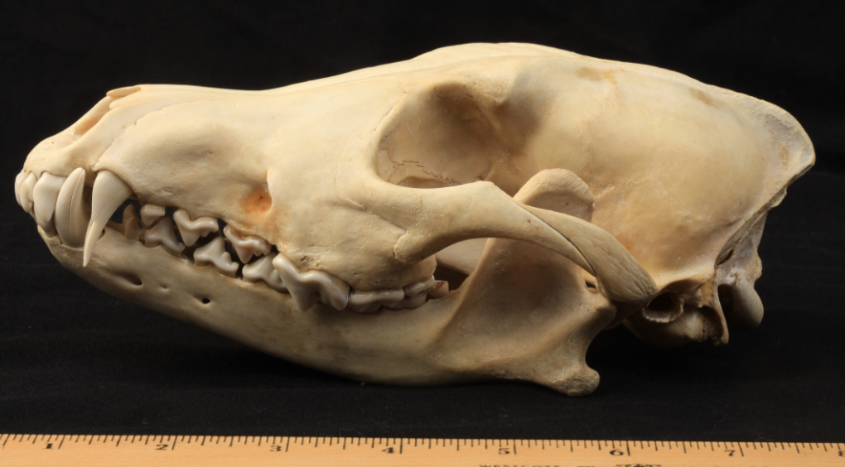
coyote
side

Slide 19
American mink
(Neovison vison)

Slide 20
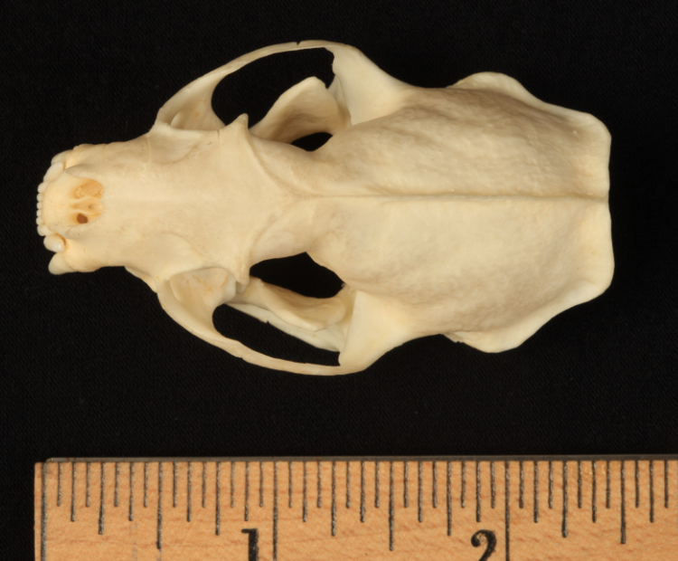
American mink
top

Slide 21
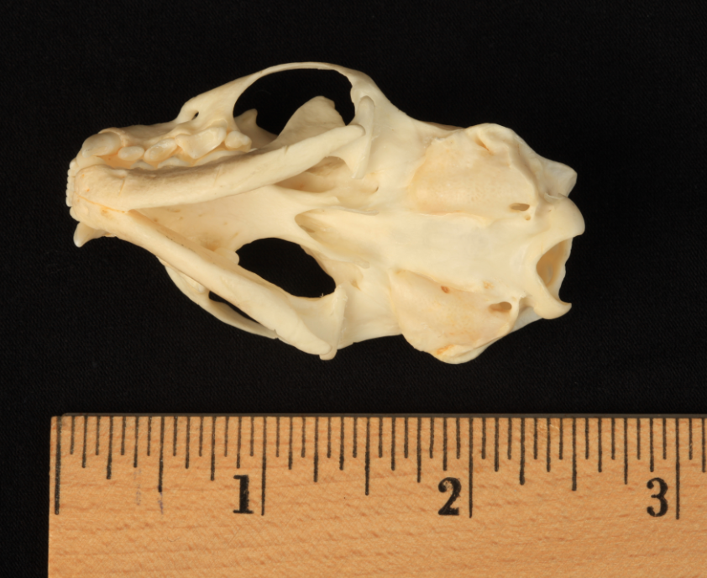
American mink
bottom

Slide 22
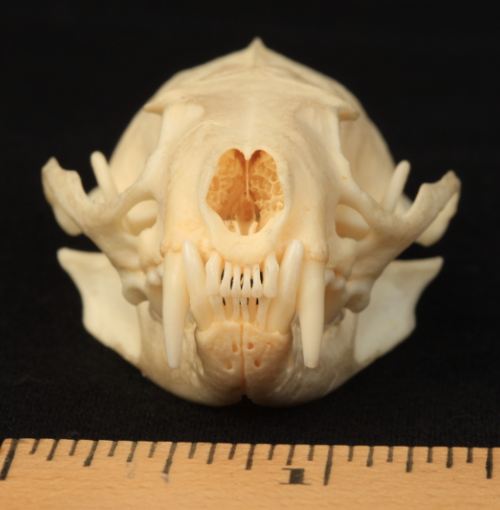
American mink
front

Slide 23
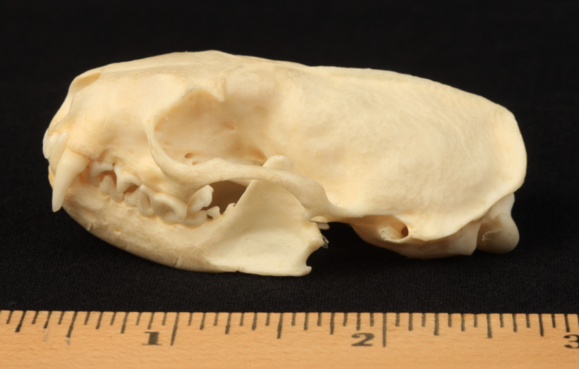
American mink
side

Slide 28
muskrat
(Ondatra zibethicus)

Slide 29
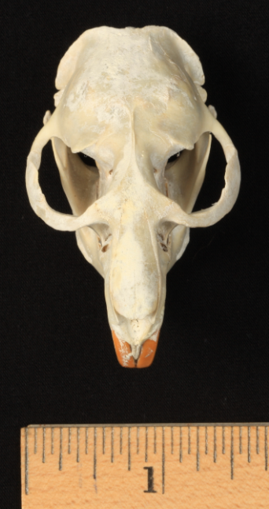
muskrat
top

Slide 30
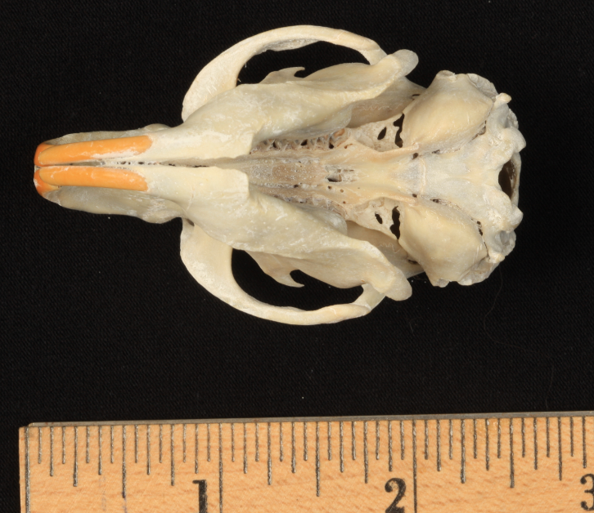
muskrat
bottom

Slide 31
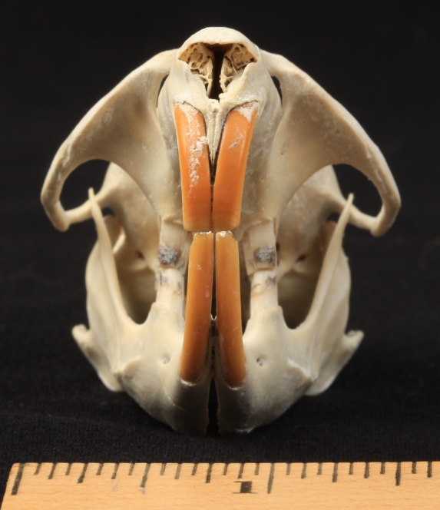
muskrat
front

Slide 32
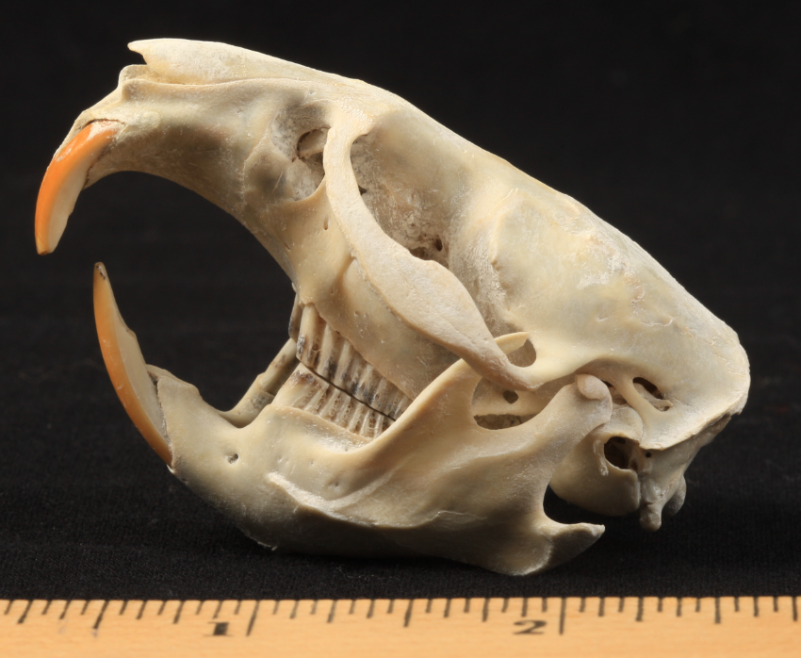
muskrat
side

Slide 37
Virginia opossum
(Didelphis virginiana)

Slide 38
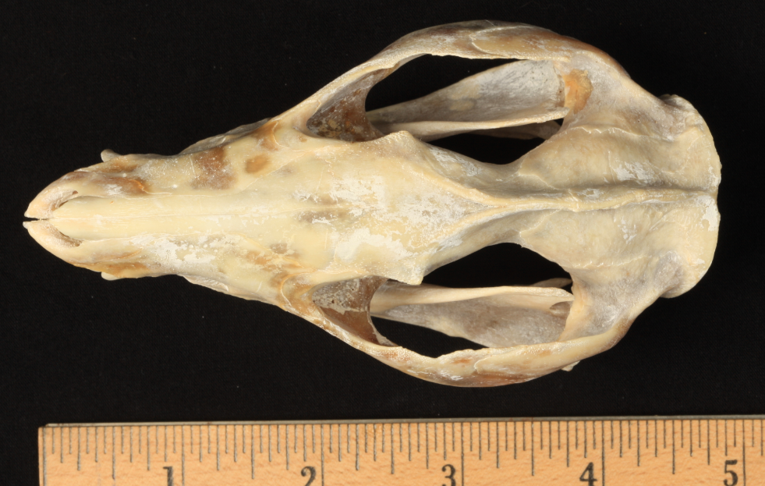
Virginia opossum
top

Slide 39
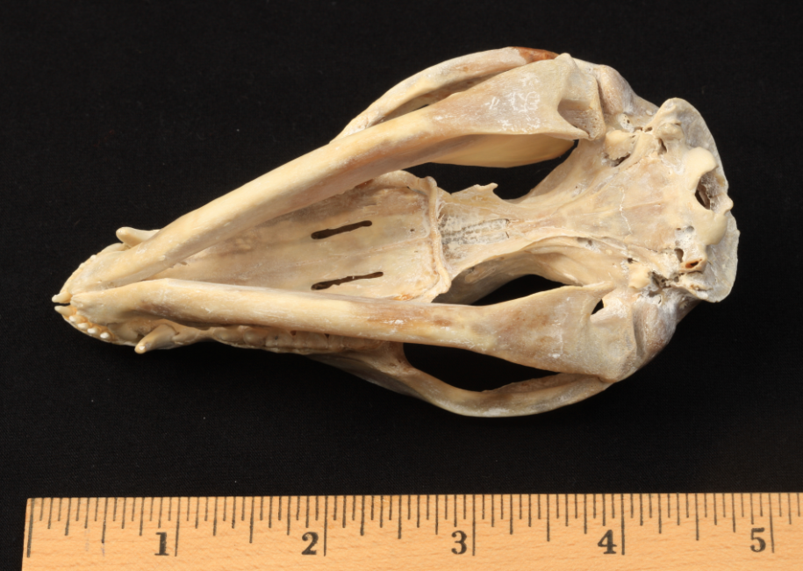
Virginia opossum
bottom

Slide 40
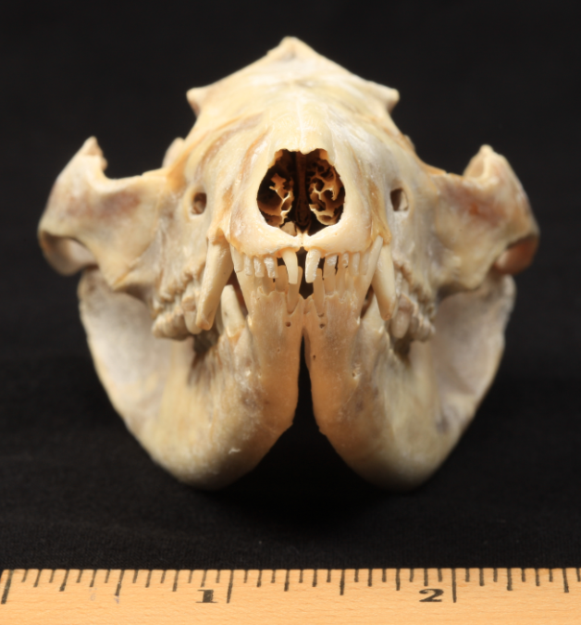
Virginia opossum
front

Slide 41
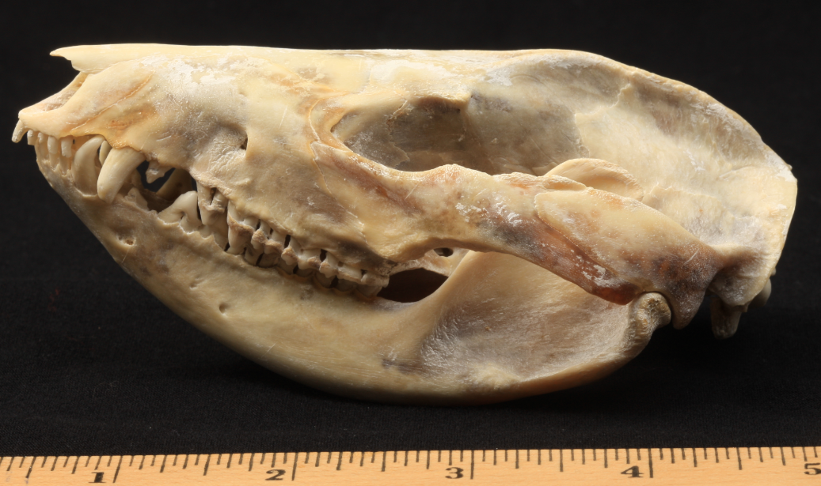
Virginia opossum
side

Slide 46
raccoon
(Procyon lotor)

Slide 47
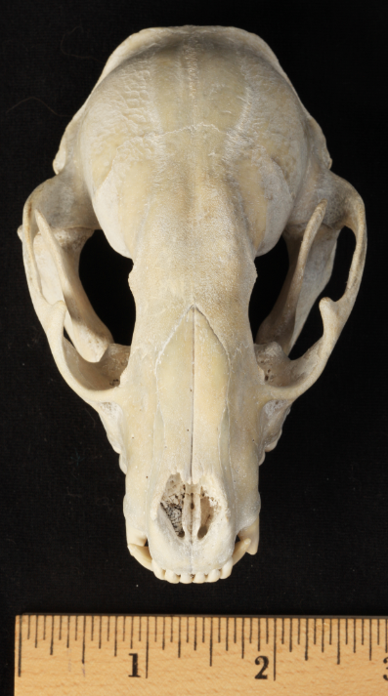
raccoon
top

Slide 48
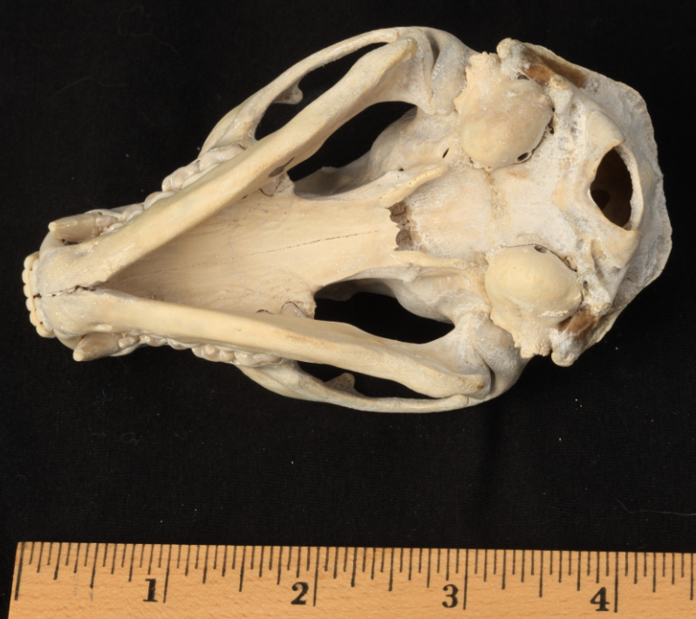
raccoon
bottom

Slide 49
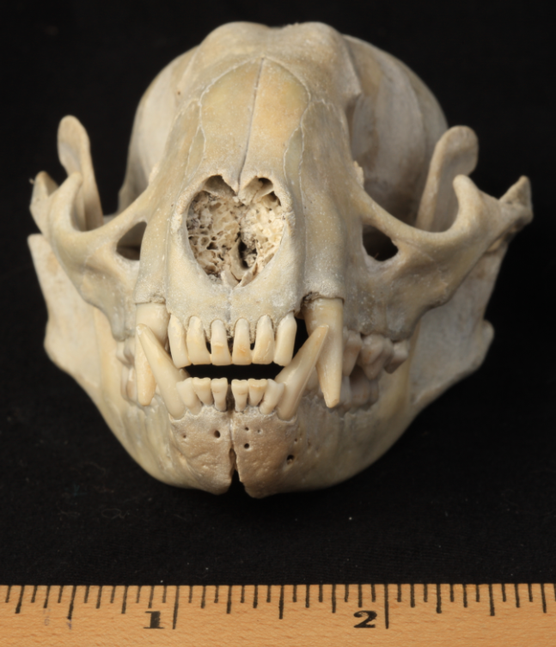
raccoon
front

Slide 50
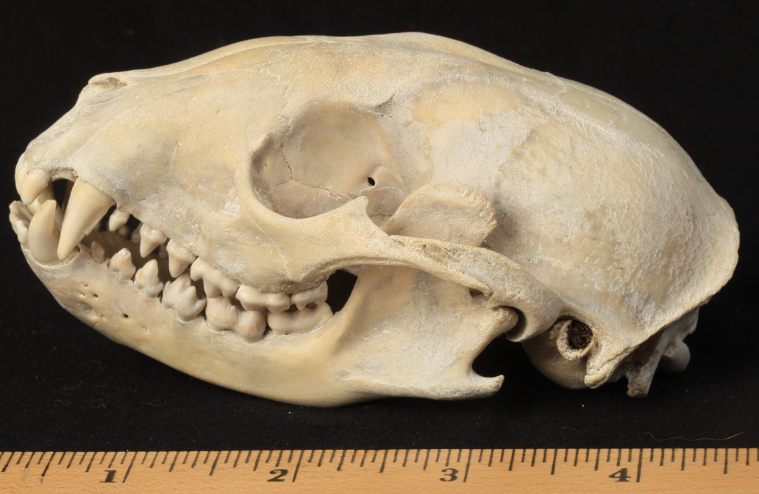
raccoon
side

Slide 55
red fox
(Vulpes vulpes)

Slide 56
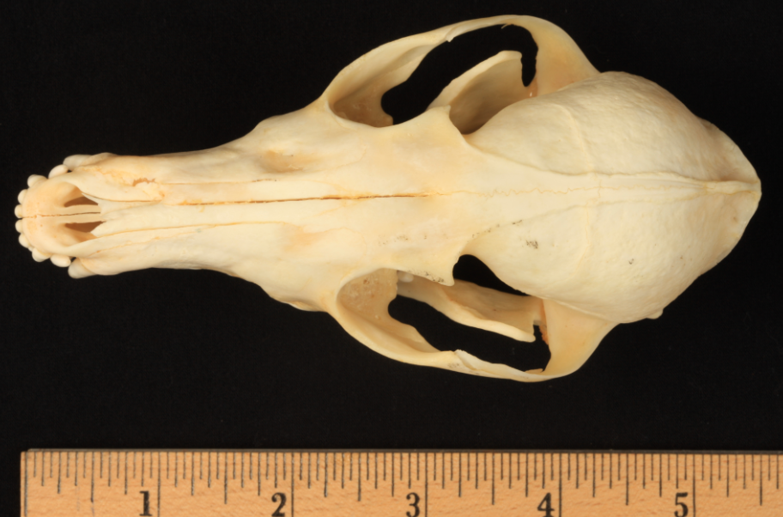
red fox
top

Slide 57
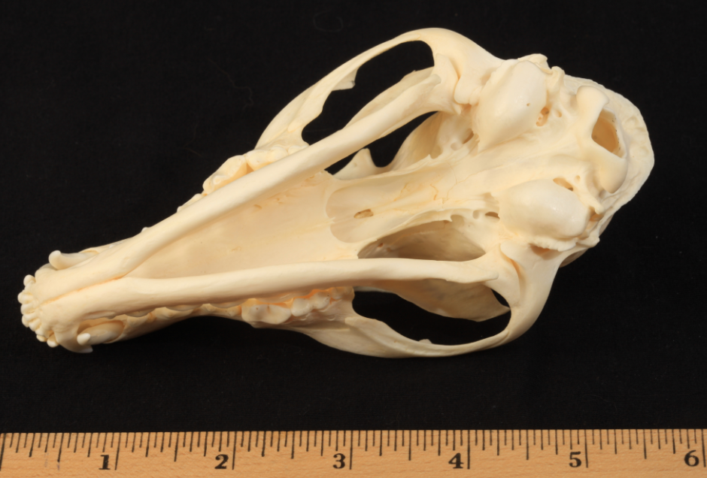
red fox
bottom

Slide 58
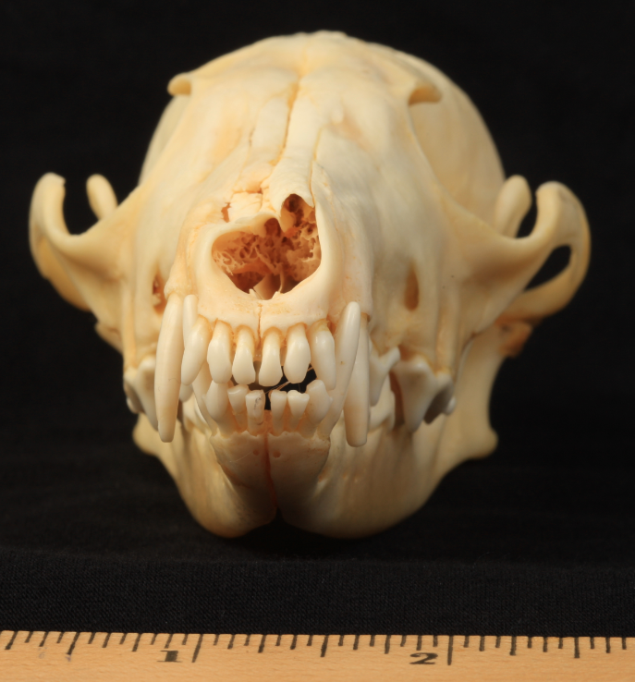
red fox
front

Slide 59
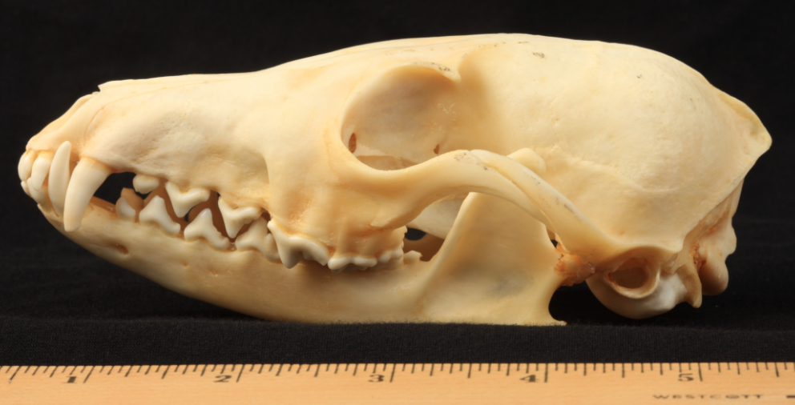
red fox
side

Slide 64
striped skunk
(Mephitis mephitis)

Slide 65
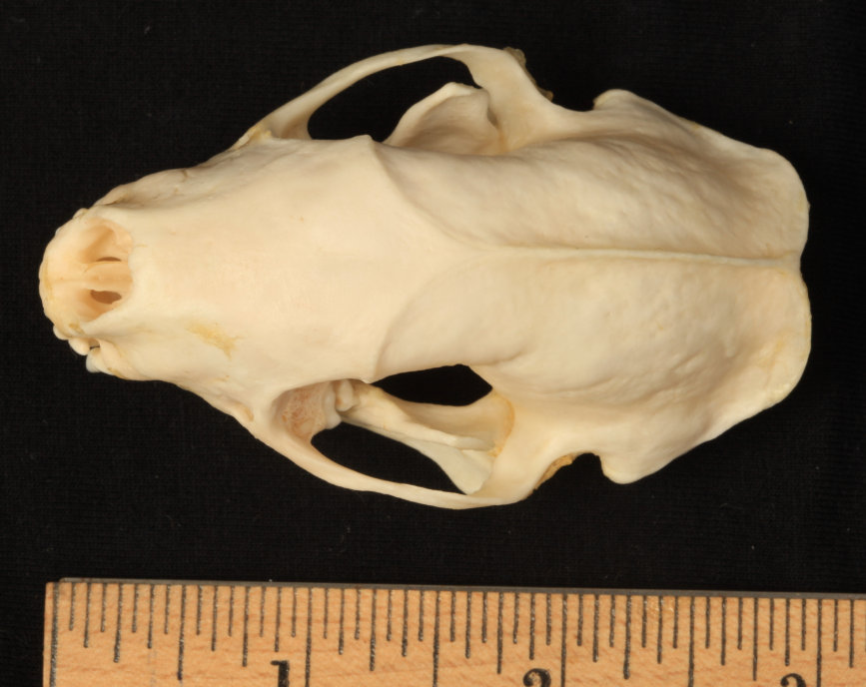
striped skunk
top

Slide 66
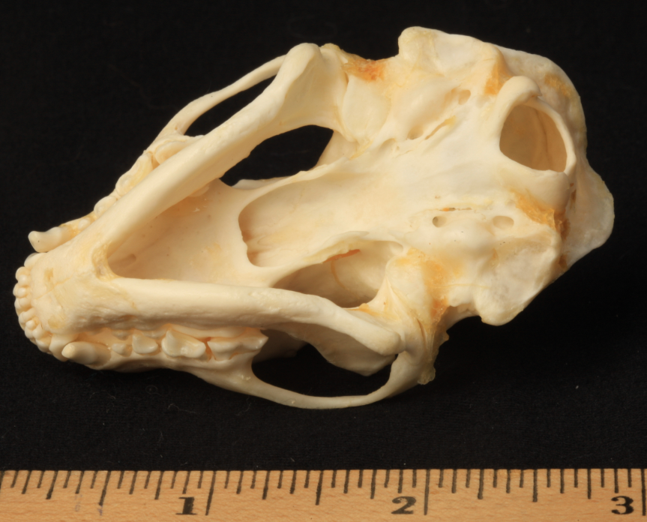
striped skunk
bottom

Slide 67
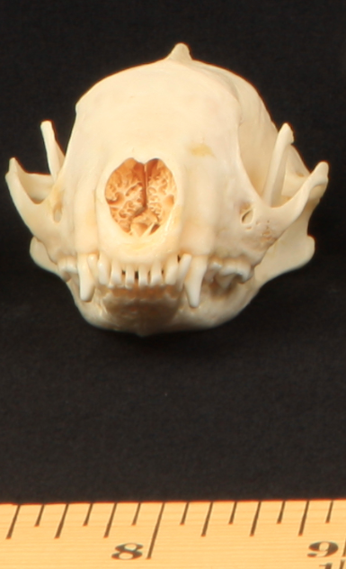
striped skunk
front

Slide 68
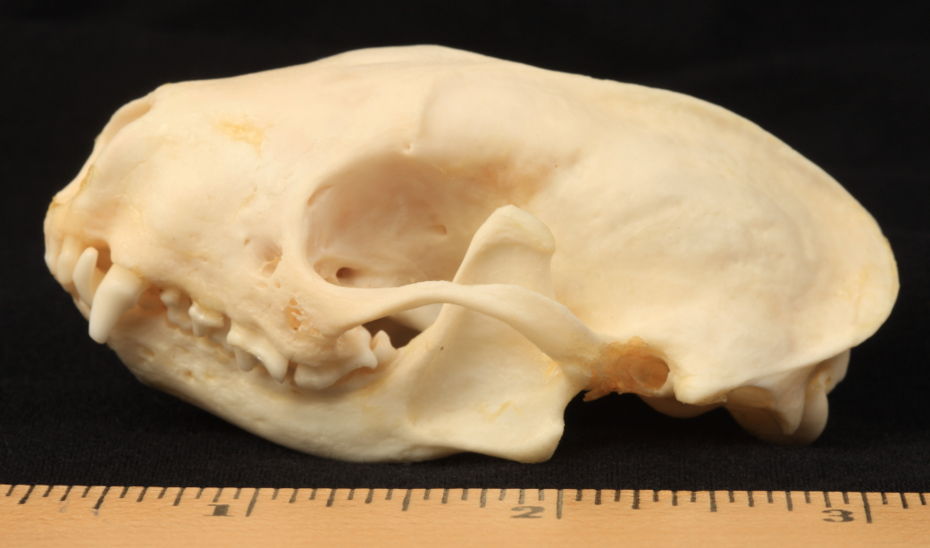
striped skunk
side

Slide 73
squirrel

Slide 74
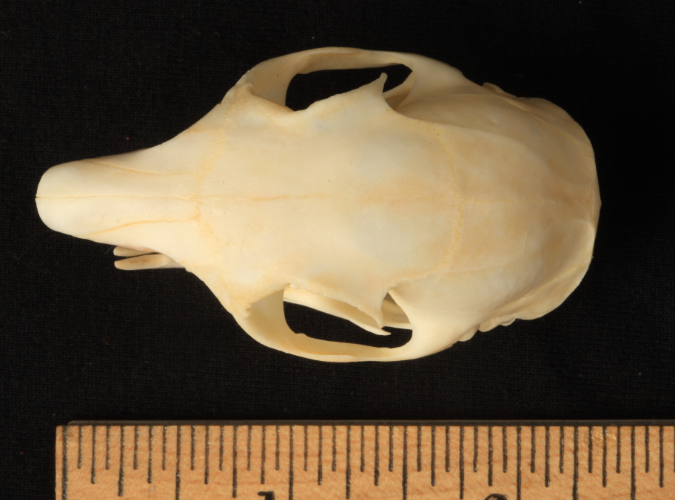
squirrel
top

Slide 75
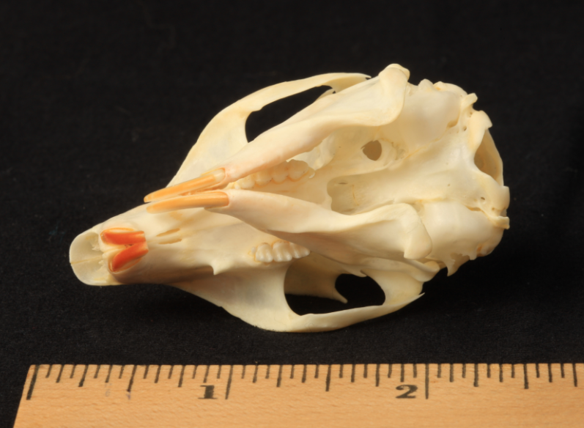
squirrel
bottom

Slide 76
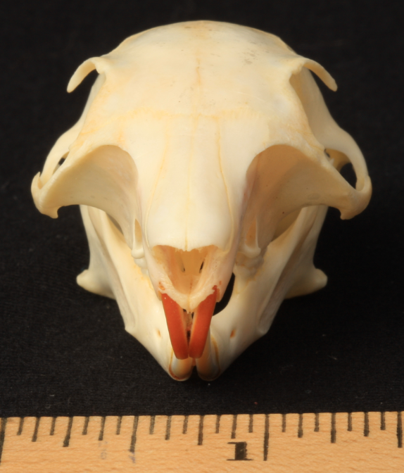
squirrel
front

Slide 77
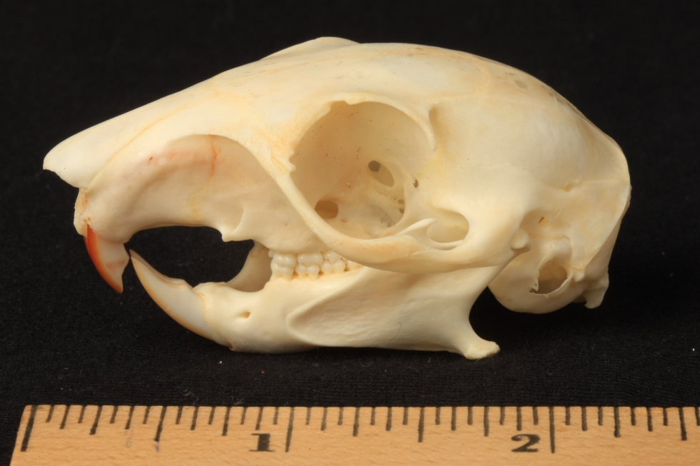
squirrel
side

Slide 82
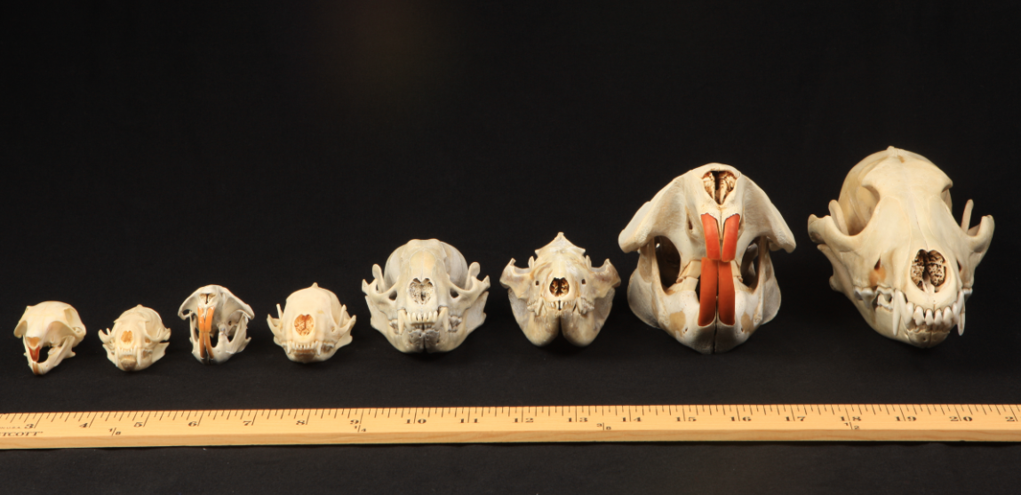

Slide 83
