Slide 1
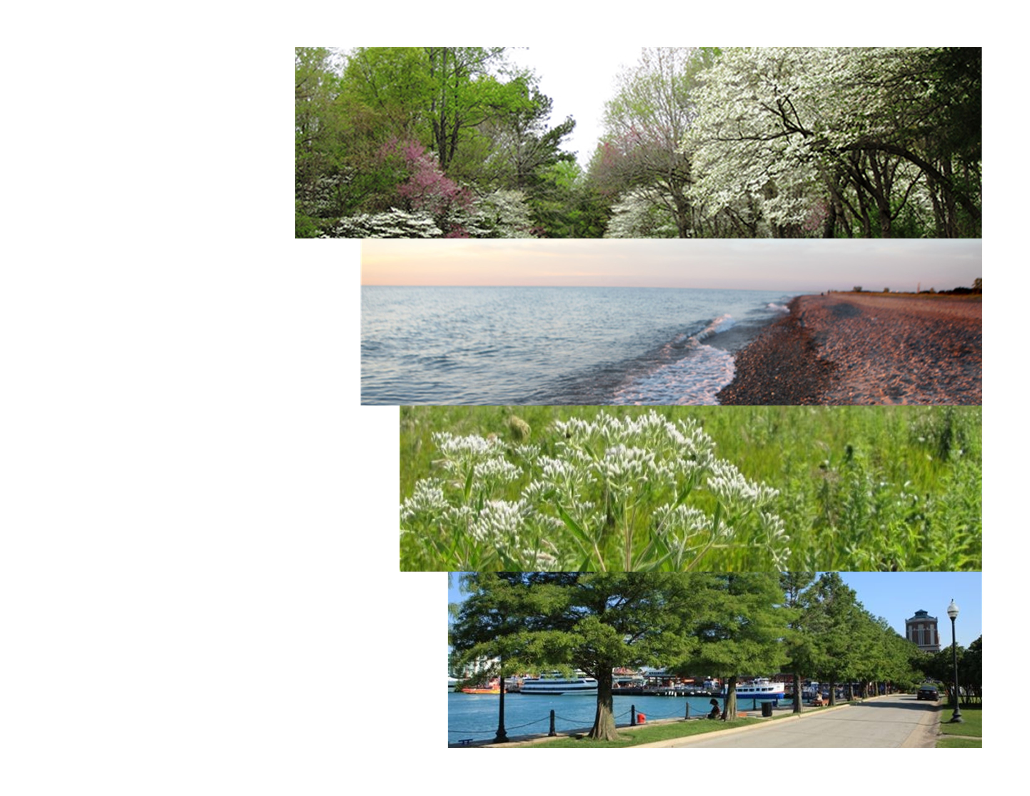
Overview of the 30x30 Initiative

Slide 2
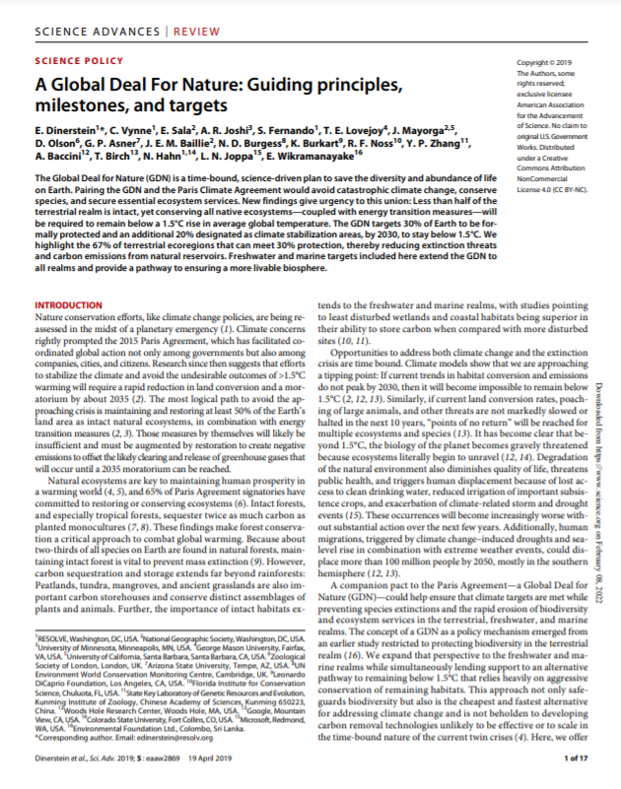
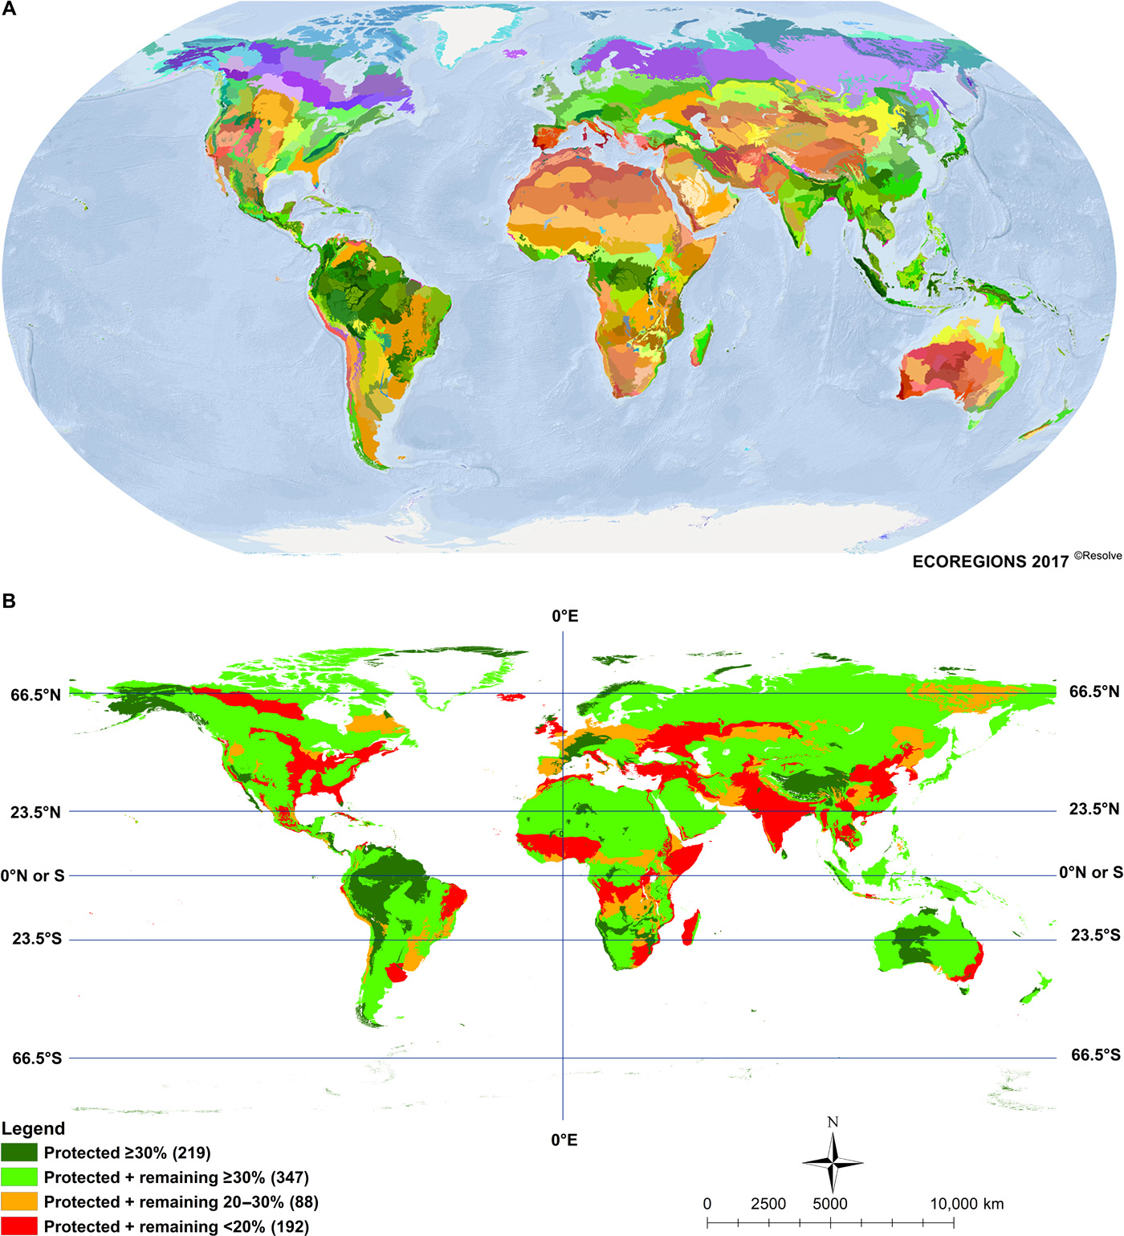
Scientists and Environmental Leaders Call for "Global Deal for Nature" to Protect Half the World's Lands and Seas (Science Advances, 2019)

Slide 3
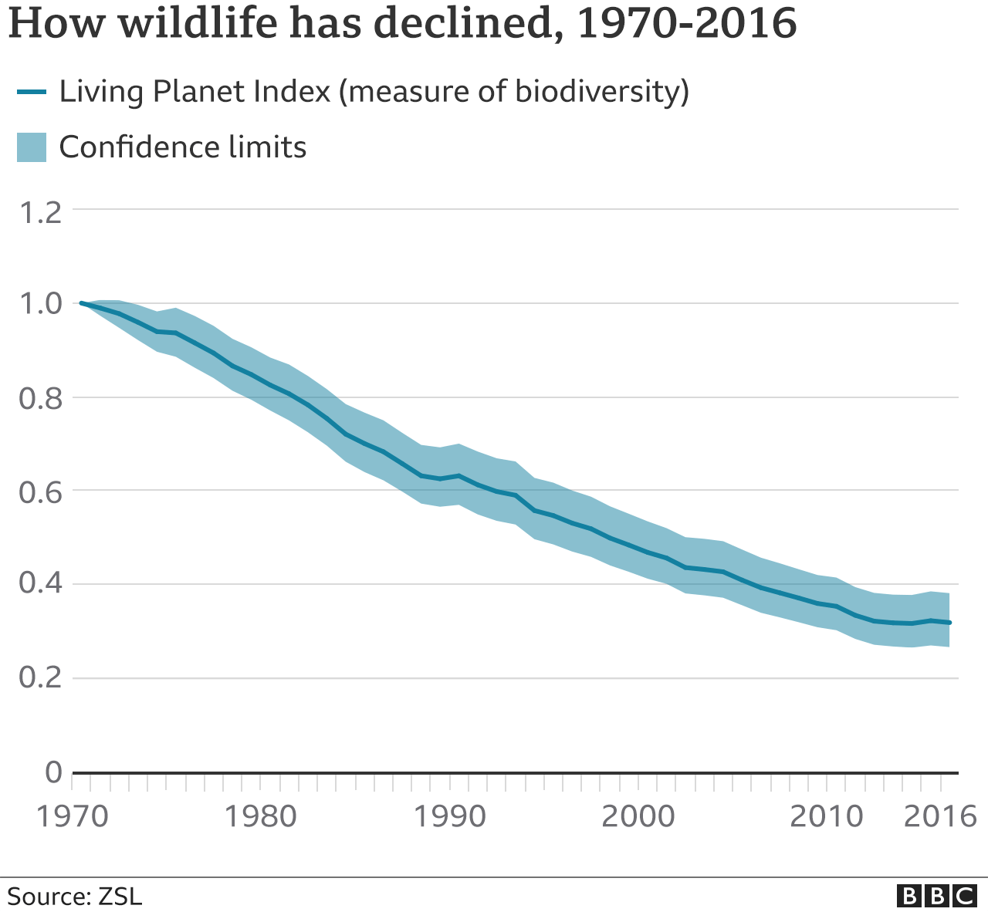
Global Nature Crisis
Climate Change mitigation alone will not protect the planet

Slide 4
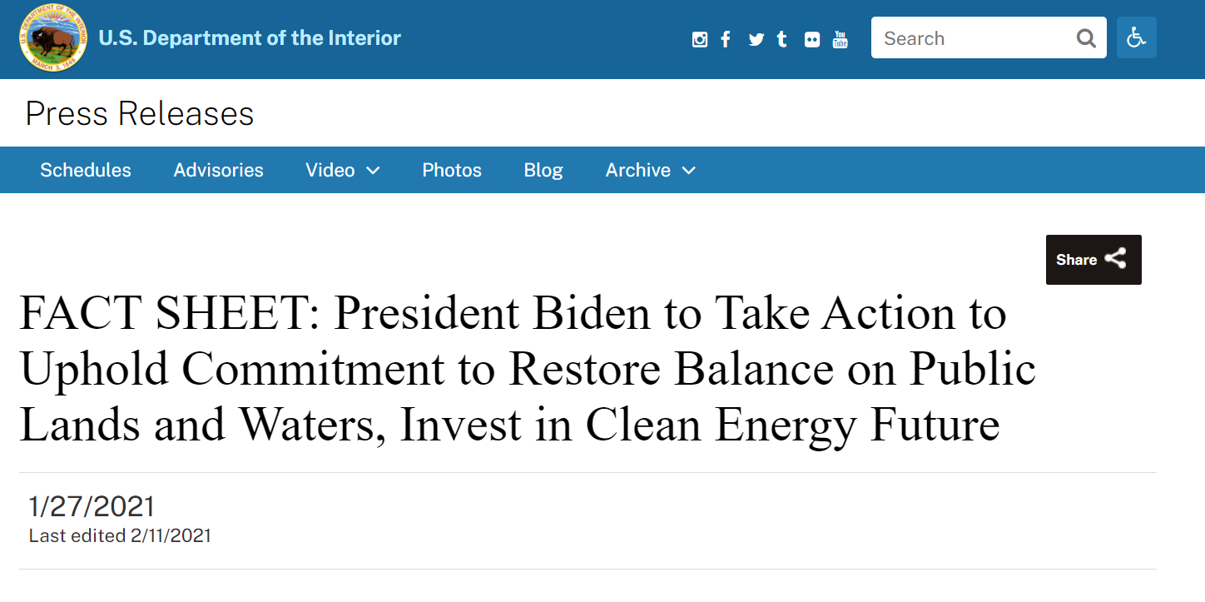
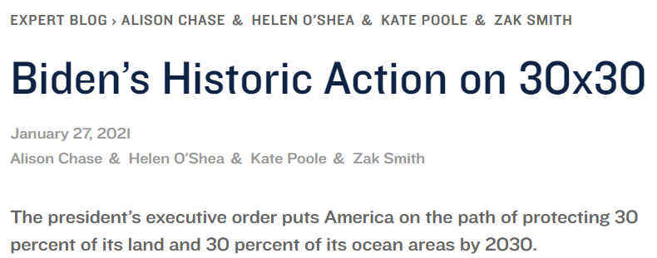
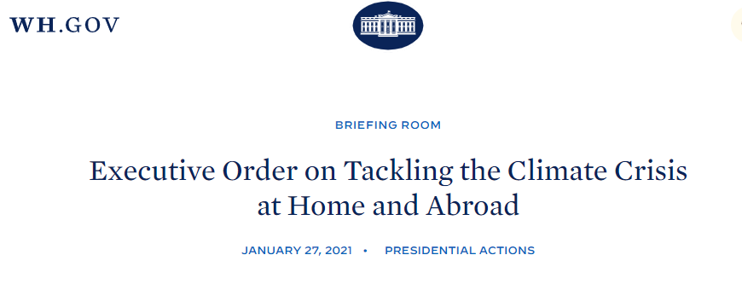
What is 30x30?

Slide 5
Conserving and Restoring America the Beautiful: Eight Principles
Pursue a Collaborative and Inclusive Approach to Conservation
Conserve America’s Lands and Waters for the Benefit of All People
Support Locally Led and Locally Designed Conservation Efforts
Honor Tribal Sovereignty; Support Priorities of Tribal Nations
Pursue Conservation and Restoration Approaches that Create Jobs and Support Healthy Communities
Honor Private Property Rights; Support Voluntary Stewardship Efforts of Private Landowners and Fishers
Use Science as a Guide
Build on Existing Tools and Strategies with an Emphasis on Flexibility and Adaptive Approaches

Slide 6
America the Beautiful: Year One Report (2021)
An update on progress made to support locally led conservation and restoration efforts across the country during the first year of the America the Beautiful initiative

Slide 7
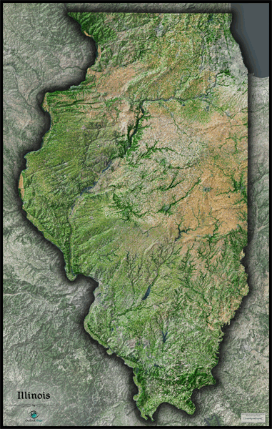

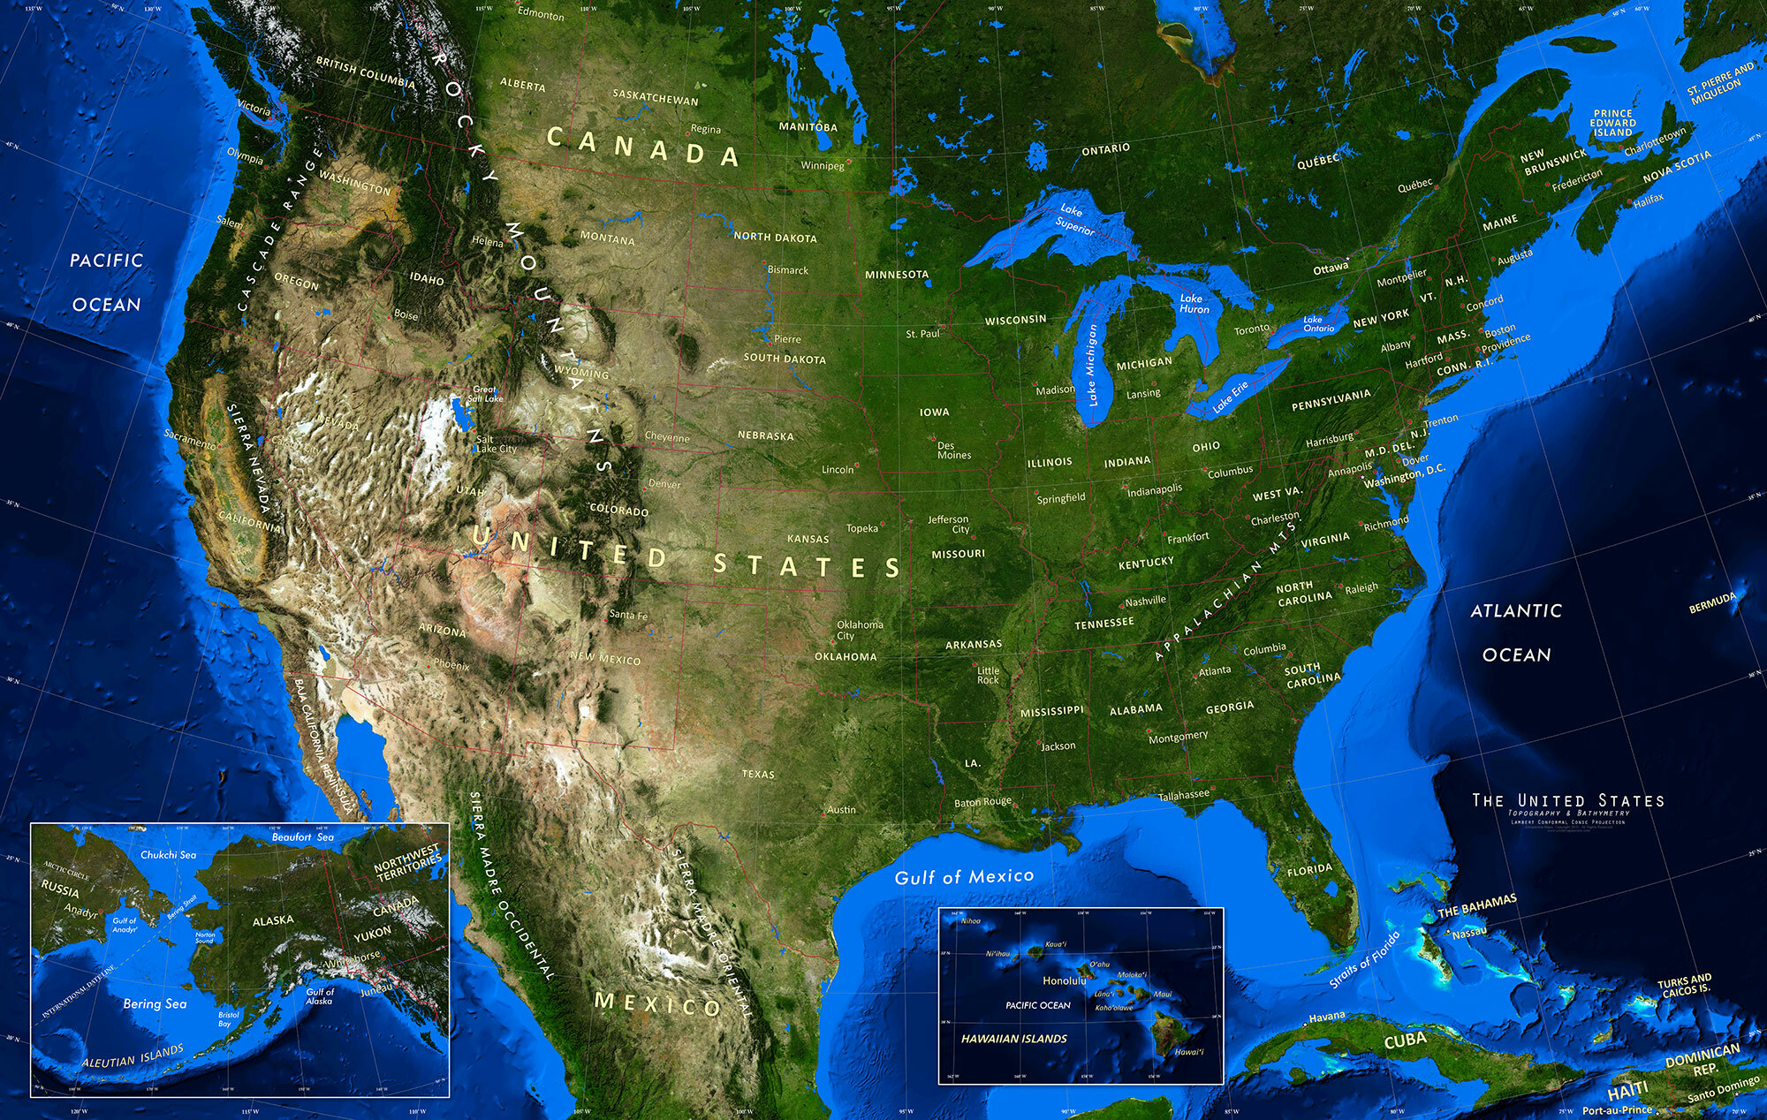

Various Scales

Slide 8
The State of Conservation in Illinois: 2022

Slide 9
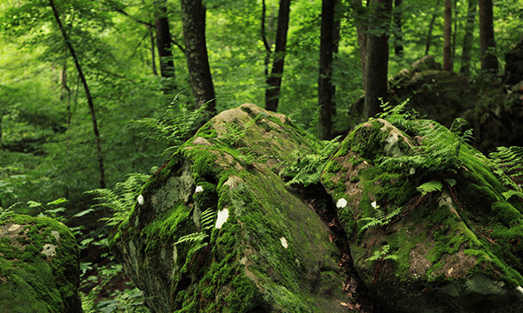
Overview

Slide 10
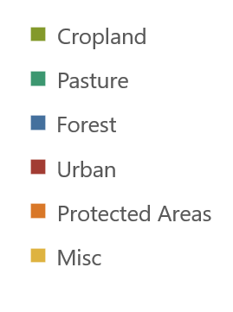
Land Use Comparison
More than two thirds of Illinois is cropland, vastly more than the national average.
By contrast, Illinois has much less forest land, pasture, or protected natural areas.
Illinois
United States
4%
4%
10%
7%
18%
13%
13%
3%
5%
29%
67%
28%
Notes:
Some forest area is also used for grazing, so the total all-agriculture land use is around 75%
This may be a good place to explain what is meant by protected land: legally protected natural land, which is a small part of the broader umbrella of conservation. But a quantifiable one.

Slide 11
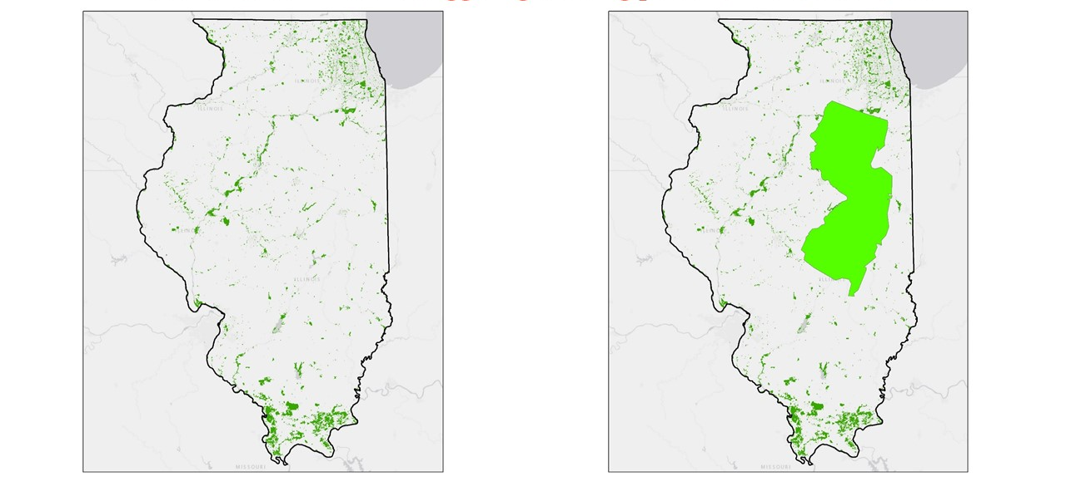
Getting to 30%?
Currently, 4.2% of Illinois, or ~1,500,000 acres, is formally protected through a variety of public and private mechanisms.
To protect 30% of the state’s land and water, over 9,000,000 acres, an area roughly the size of New Jersey, would need to be added.
The state has added just 27,000 acres (0.07%) of protected areas in the last five years.

Slide 12
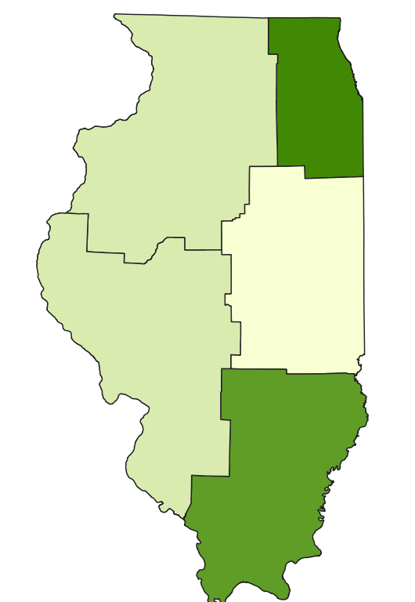
Regional Comparison
Northern and Southern Illinois host major protected areas such as Midewin National Tallgrass Prairie and Shawnee National Forest.
Central Illinois is primarily devoted to agriculture, so has a smaller share of protected areas.
Northwest
Northeast
East Central
West Central
Southern

Slide 13
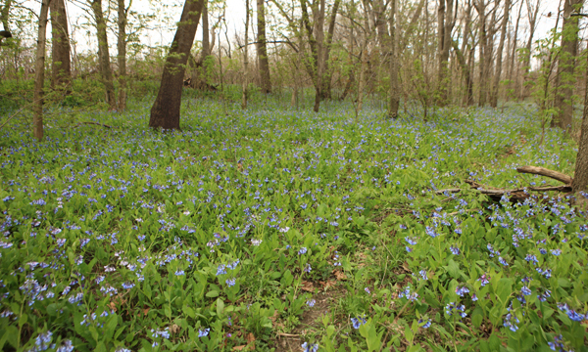
Protection and Conservation
Notes:
Alternatively, we could explain the distinction between protection and conservation here.

Slide 14
Protected Lands Breakdown
The vast majority of protected natural areas in the state are publicly owned, with privately held land and water making up only 5.5%.
Across both public and private, ownership is much more common than easements.

Slide 15
Protected Lands Overlap
Protections can overlap, especially when easements cover areas owned by conservation interests.
Because of this, it is difficult to assign the share of protected areas to a given type of ownership.

Slide 16
Expanding the Umbrella
Areas do not have to be legally protected in order to provide a conservation benefit.
The Conservation Reserve Program and Forestry Development Programs both partner with private landowners to ensure conservation practices on their land.
These two programs alone include roughly as much land as all formal protection combined.
Different programs contribute to goals like biodiversity and climate mitigation in different ways
*CRP - Conservation Reserve Program, CREP - Conservation Reserve Enhancement Program, CSP - Conservation Stewardship Program, IRAP - Illinois Recreational Access Program
Notes:
As Leon noted, we should emphasize that we are not saying these non-protected lands are equivalent to legally protected parks and wildlife areas. They are very different but still need to be considered in a fully accounting of conservation.

Slide 17
Encouraging Conservation
There are other, non-quantified, State programs encouraging conservation practices on otherwise used land.
Partners for Conservation: IL Department of Agriculture partnership with Soil & Water Conservation Districts to offer “cost-share” dollars to operators/owners to implement many types of conservation practices.
Stream Bank Stabilization and Restoration Program: IDOA program demonstrating effective, inexpensive vegetative and bio-engineering techniques for limiting stream bank erosion and preserving aquatic habitats.
Solar Pollinator Program: IDNR certifies solar sites that meet criteria for providing pollinator habitat at solar facilities.

Slide 18
Sources
Land Use data from
  USDA Economic Research Service
Protection and Conservation data from
  Illinois Department of Natural Resources
  Illinois Department of Agriculture
  Prairie State Conservation Coalition
  Openlands
  Protected Planet
  USDA Farm Service Agency
Template from
  Slides Carnival

