Slide 1
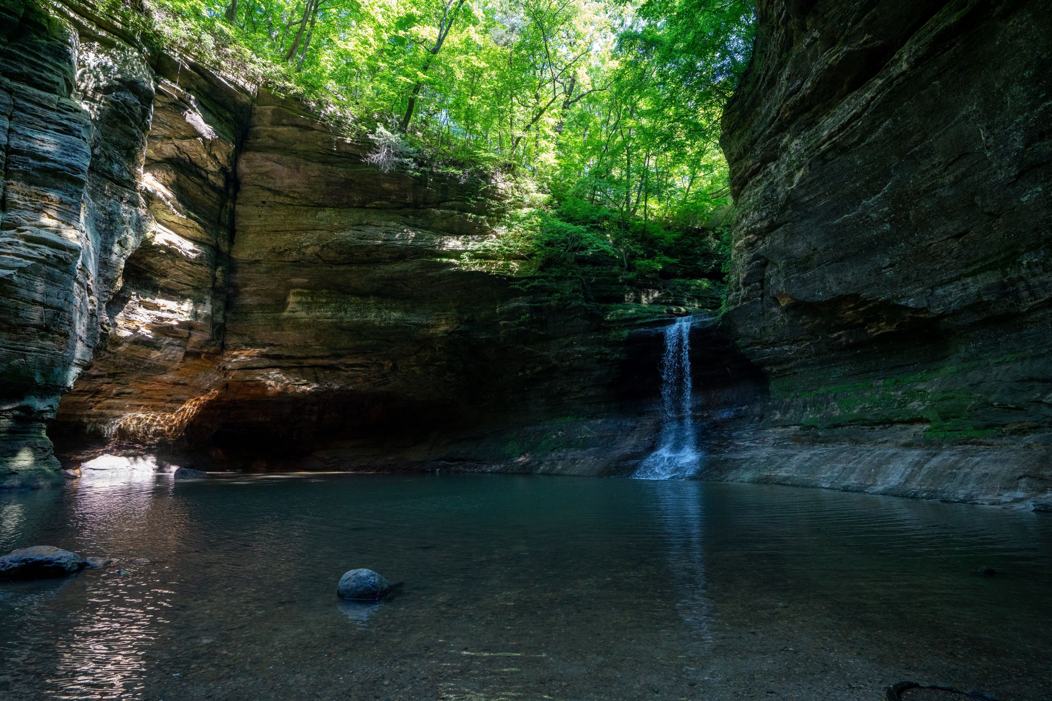
A Vision for Illinois Landscape
To inform 30x30 recommendations
Notes:
Introduction of the presenter

Slide 2
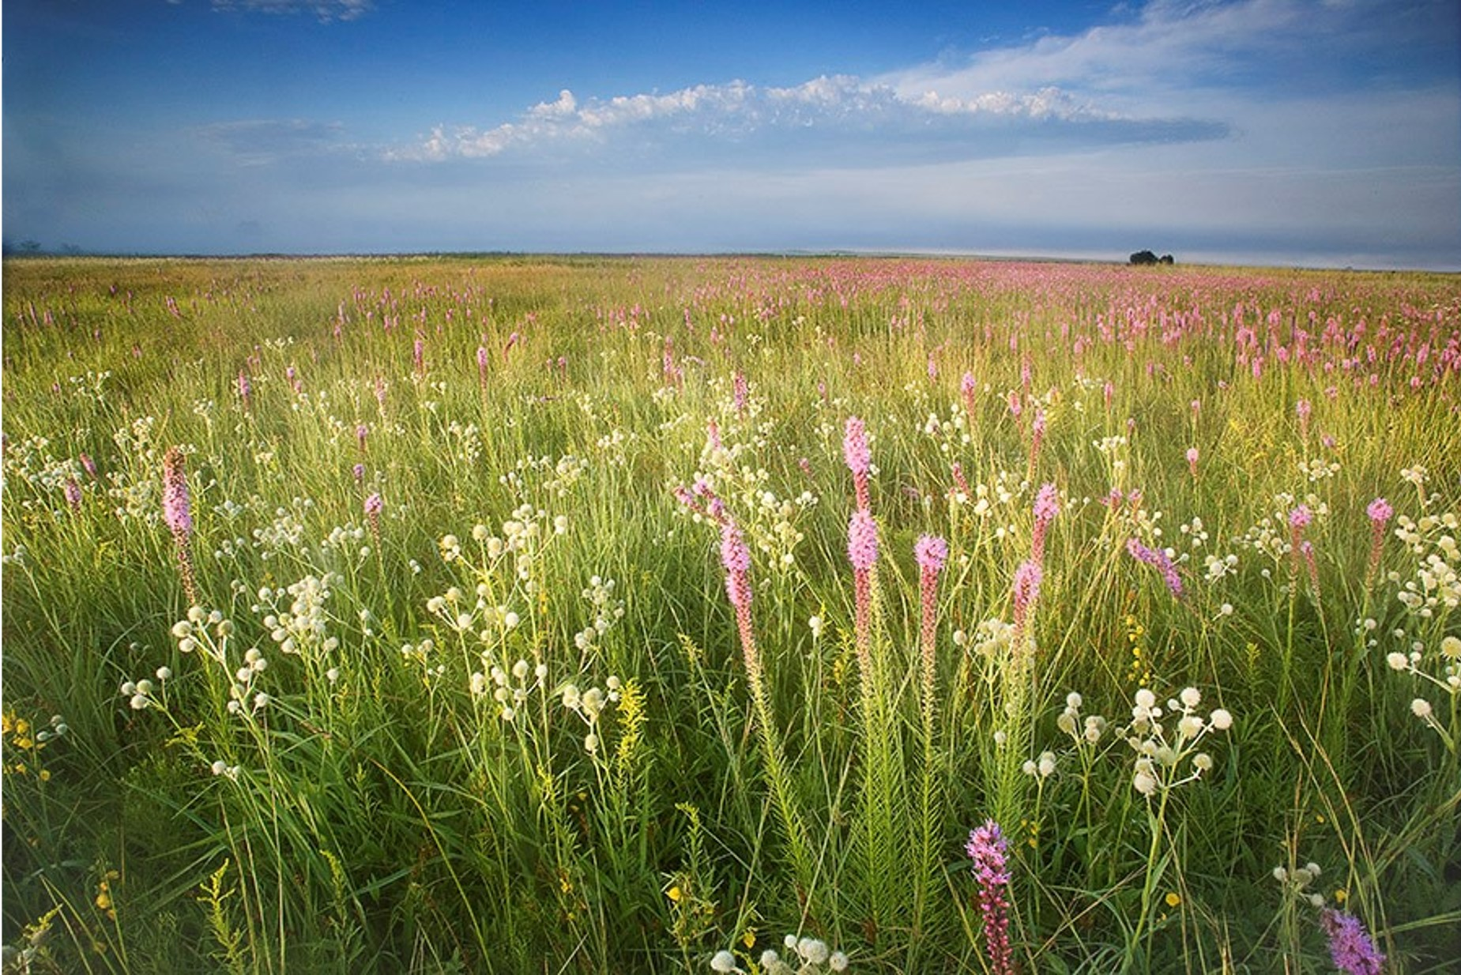
The Need for a Vision
Illinois’ 30x30 Initiative is meant to advise on the establishment of a bold goal for conserving the land and waters of Illinois for the dual purposes of biodiversity protection and climate mitigation.
Why do we need a Vision to guide us?
  To motivate us to action
  To assess our progress
  To celebrate our successes
Notes:
Most land in Illinois, and essentially all waters, are impacted by or directed toward human use. Even protected areas which make up a tiny fraction of the landscape are managed by people to meet human priorities. This will not change. What can change is how we determine these priorities and the magnitude of the impact that our activities have on other organisms that share the landscape with us.
The Task Force was formed to recommend approaches to address the threats to native biodiversity and a changing climate.
Why do we need a Vision?
In order to develop goals for land and water conservation we need to imagine possible futures for Illinois.
A positive vision of the future will align with your values.
A shared vision established with common values will enable us to develop collective goals and realistic recommendations.

Slide 3
Common Values that might inform the Vision
All residents living and working in Safe and Healthy Environments
Vibrant and sustainable economies existing throughout the state
All communities having equitable local access to Open Spaces
Land Protection yields equitable distribution of benefits to all people
Ecologically Important Areas are effectively managed and protected
Key Terrestrial and Aquatic Habitats are connected across the state
All types of land share in mitigating climate change
Robust Populations of Native Species exist statewide
Notes:
Examples of common values that might inform a Landscape Vision include those listed here. There are many other possibilities.
These values were taken from what was heard during the listening sessions and written comments submitted to the Task Force.
One expression of these values might be a Vision Statement such as this (see next slide).

Slide 4
A Proposed Vision for Illinois’ Landscape
The Illinois landscape maintains native species, mitigates climate change, and provides equitable access to nature’s benefits to all residents.
People in Illinois live and work in safe and healthy communities with vibrant economies, equitable local access to open spaces, and that support native species while contributing to a sustainable future.
Private landowners regularly adopt voluntary conservation measures that sustain Illinois’ native plant and animal communities, mitigate climate change, and support recreational and economic activities throughout the state.
Notes:
This statement was developed as a reflection of the Values presented in the previous slide.
There are many strategies to move toward such a Vision that include placing 30% of Illinois’ Land and Water into conservation.

Slide 5
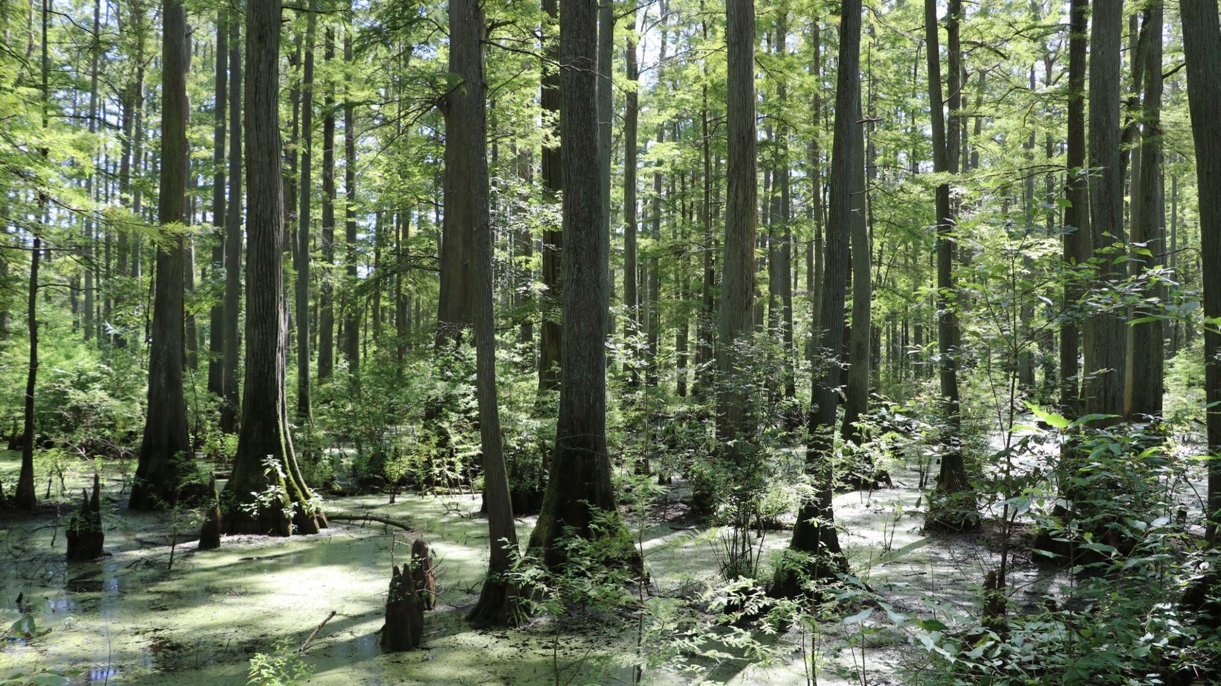
Review of Conservation Programs
To inform 30x30 recommendations
Notes:
Introduction of the presenter

Slide 6
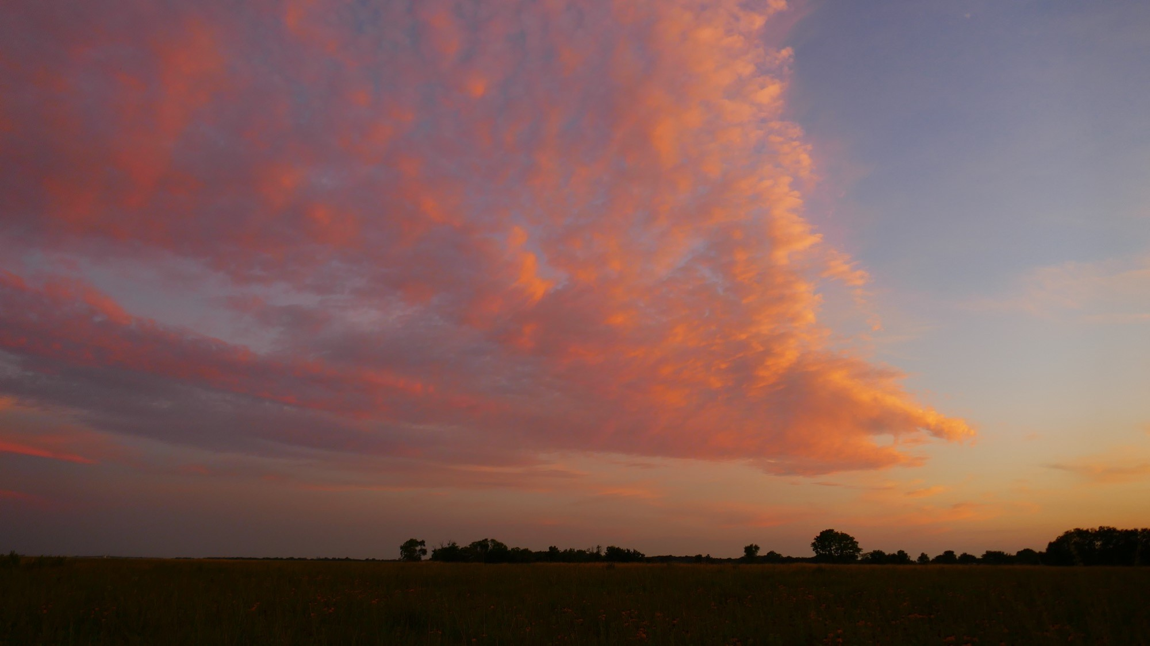
Agricultural Areas
IDNR Agricultural Lease Lands
FSA Conservation Reserve Program
IDNR Conservation Reserve Enhancement Program
NRCS Environmental Quality Incentives Program
IDoA Partners for Conservation
IDoA Fall Covers for Spring Savings
IDoA Stream Bank Stabilization Program
IEPA Section 319
Notes:
Both programs that take land out of production for some amount of time, and programs that improve ecosystem services of land in production

Slide 7
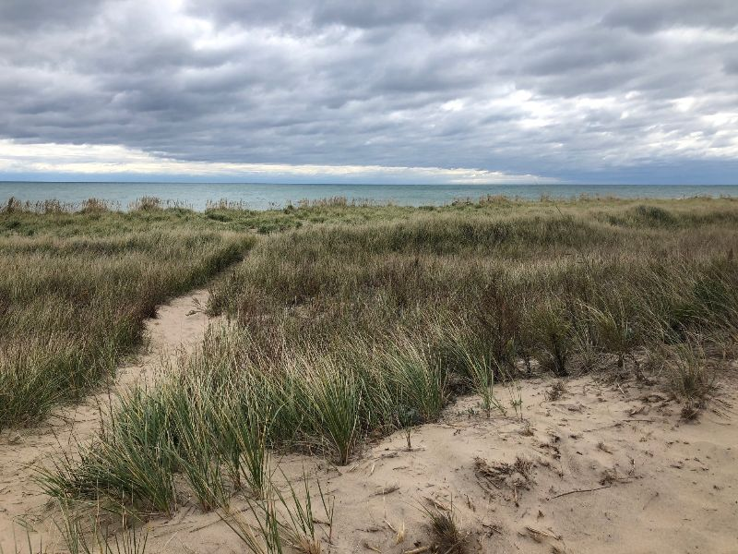
Cities and Towns
Public Conservation Areas
  State
  Local
Conservation Land Trust Areas
IDOT Right of Way Lands
Nature Preserves
IDNR OSLAD Grants
IDNR Coastal Grants
Urban Forestry
IEPA Green Infrastructure Grants
Private Habitat Registration (Conservation @ Home)
Notes:
Both how we increase access through general programs and how we improve programs focused on urban areas

Slide 8
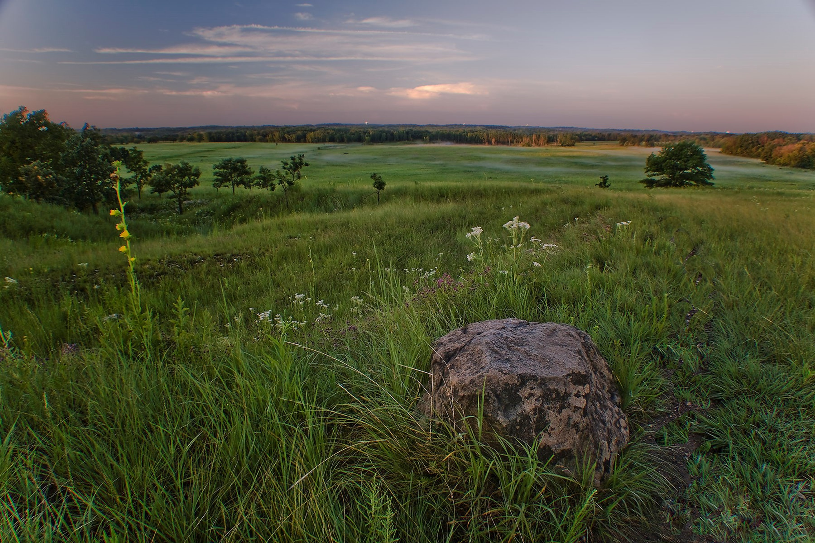
Natural Lands and Waters
Public Conservation Areas
  Federal
  State
  Local
Conservation Land Trust Areas
IDOT Right of Way Lands
Nature Preserves
USFWS Partners for Fish & Wildlife Program
IDNR Forestry Programs
IDNR Conservation Stewardship Program
IDNR Illinois Recreational Access Program
NRCS Wetland Reserve Program
Solar Pollinator Scorecard Program
National Monarch Candidate Conservation Agreement
Notes:
Both public land (and permanent easements) and voluntary, private agreements and certification

